Slide 1
Images for User Guide

Slide 2
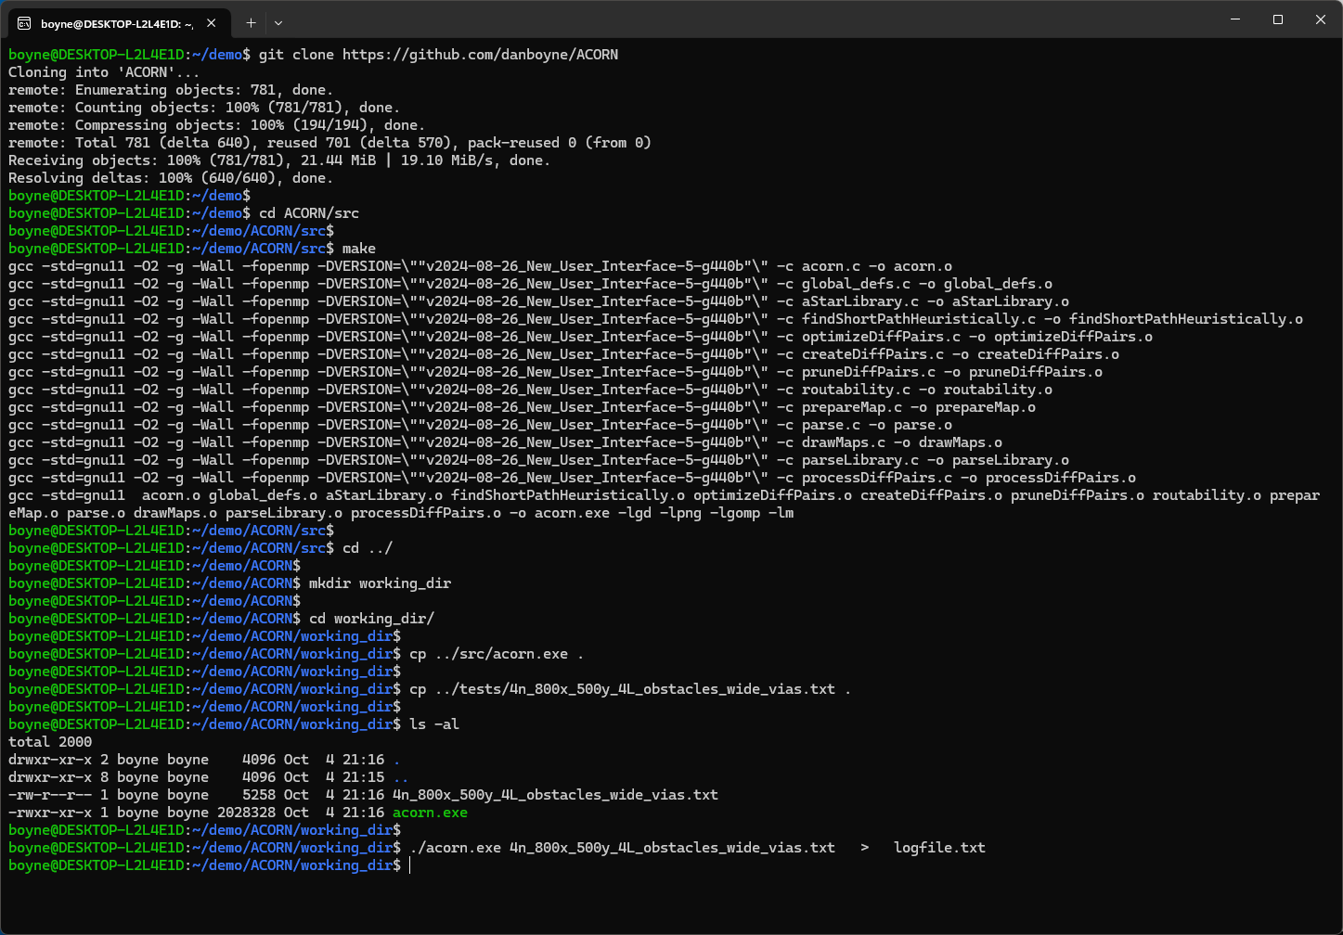
Download Acorn from GitHub
Type 'make' in 'src' directory to compile Acorn.
Create a working directory
Copy 'acorn.exe' and a test-case to the working directory
Run Acorn

Slide 3
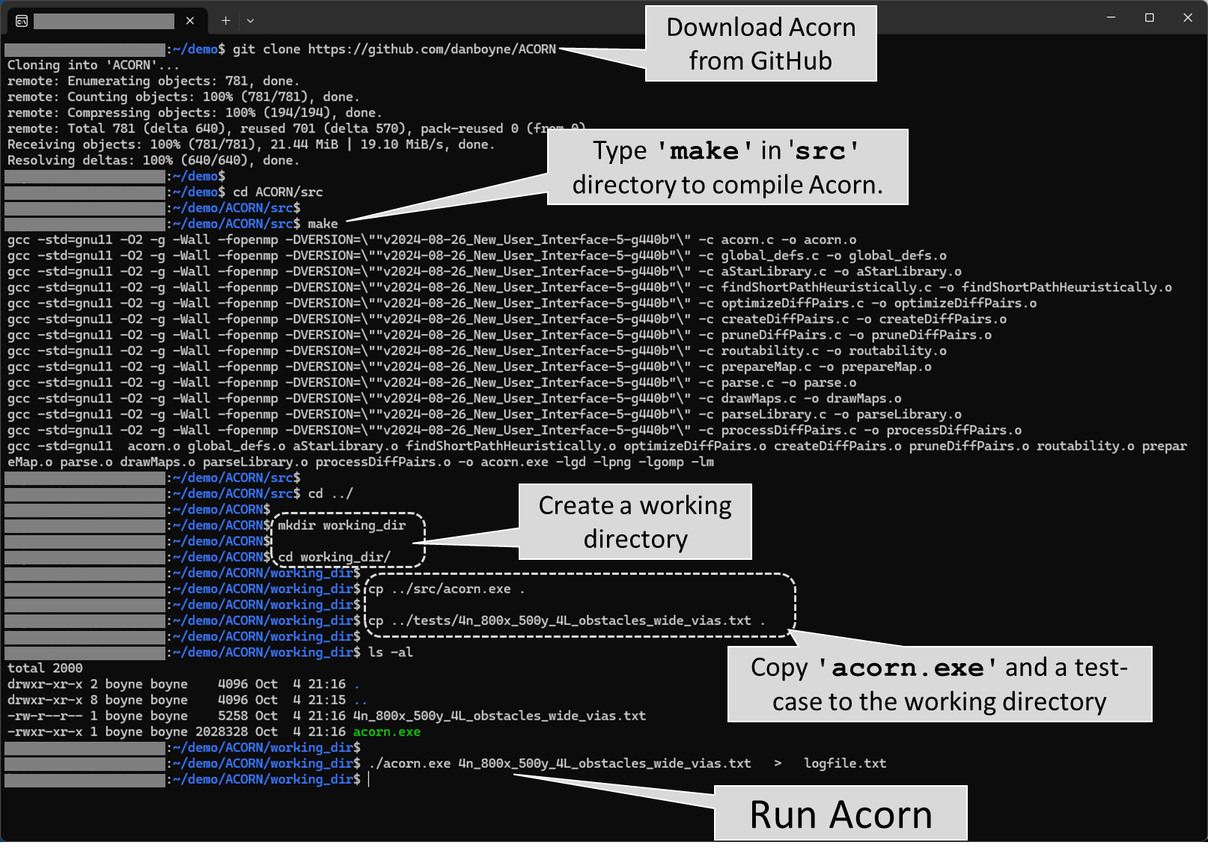

Slide 4
Perspective view of test-case 8n_800x_500y_4L_obstacles_diffPairs_PNswappable_costZones_designRuleZones:
M1:
===
block rect M1 750 450 800 500
block TRI M1 600 300 500 300 600 400
V12:
====
block all V12
unblock CIR V12 175 175 125
M2:
===
BLOCK ALL M2
unBLoCK RECT M2 5 5 795 495
block TRI M2 400 100 300 100 400 200
M3:
===
block TRI M3 200 100 100 100 200 200
block TRI M3 100 200 150 400 510 180
M4:
===
block rect M4 650 350 725 425
BLOCK CIR M4 600 200 100
Start-
terminals
M1
Routing
obstacles
V12
M2
V23
M3
V34
M4
End-
terminals

Slide 5
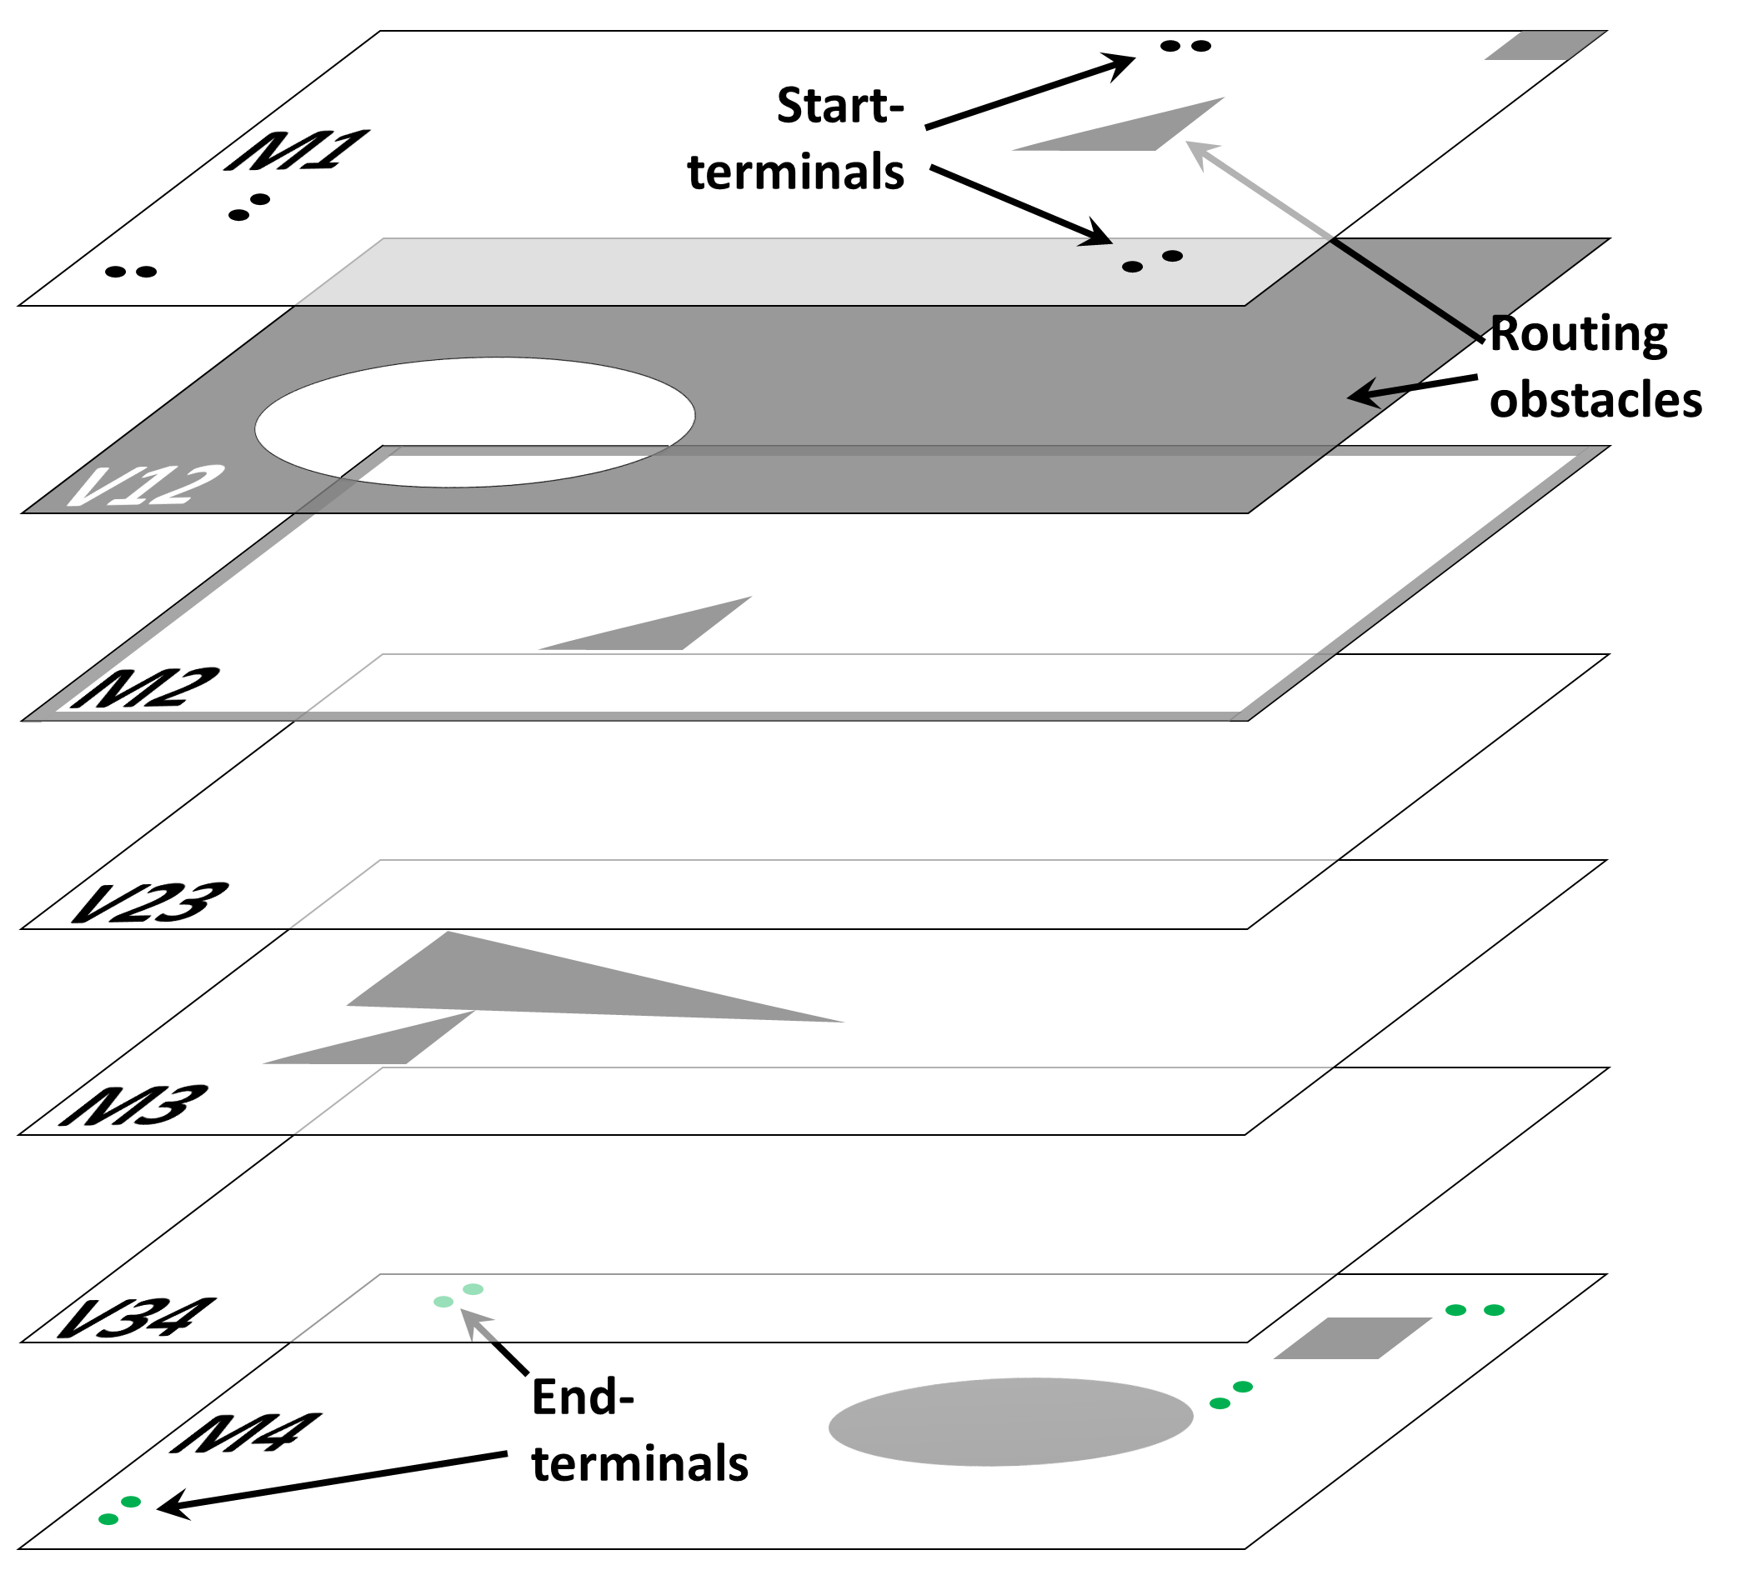

Slide 6
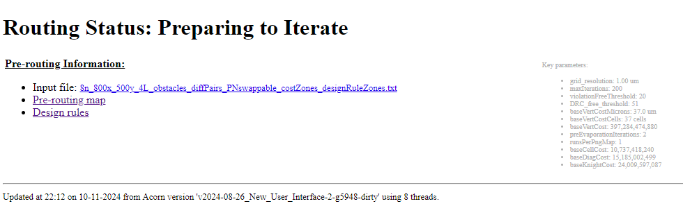
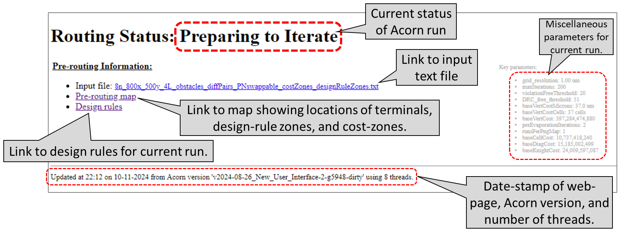
Current status of Acorn run
Miscellaneous parameters for current run.
Link to input text file
Link to map showing locations of terminals, design-rule zones, and cost-zones.
Link to design rules for current run.
Date-stamp of web-page, Acorn version, and number of threads.

Slide 7
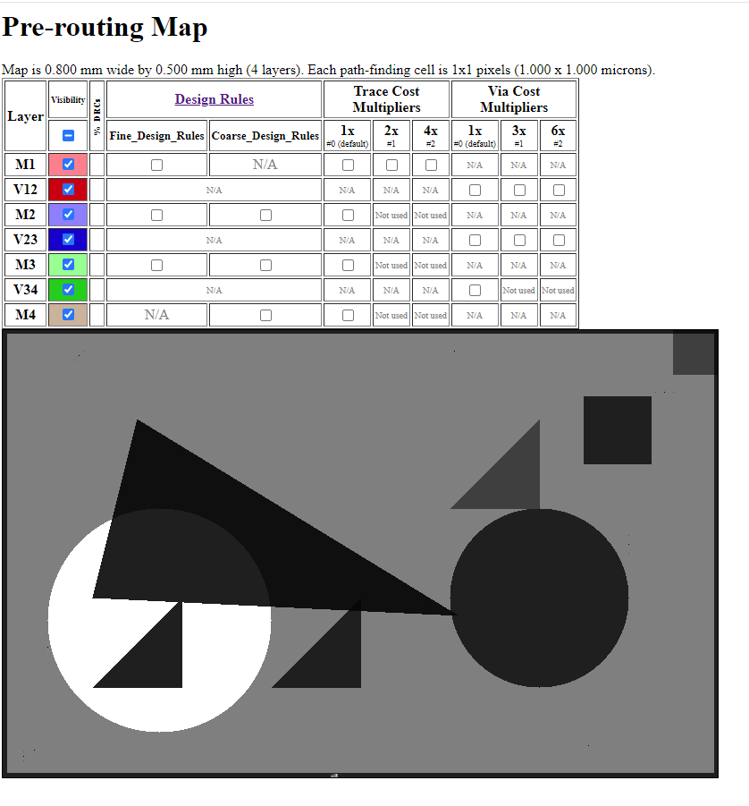
Toggle the visibility of any layer
All layers are overlaid in this routing area
Routing obstacles shown in black

Slide 8
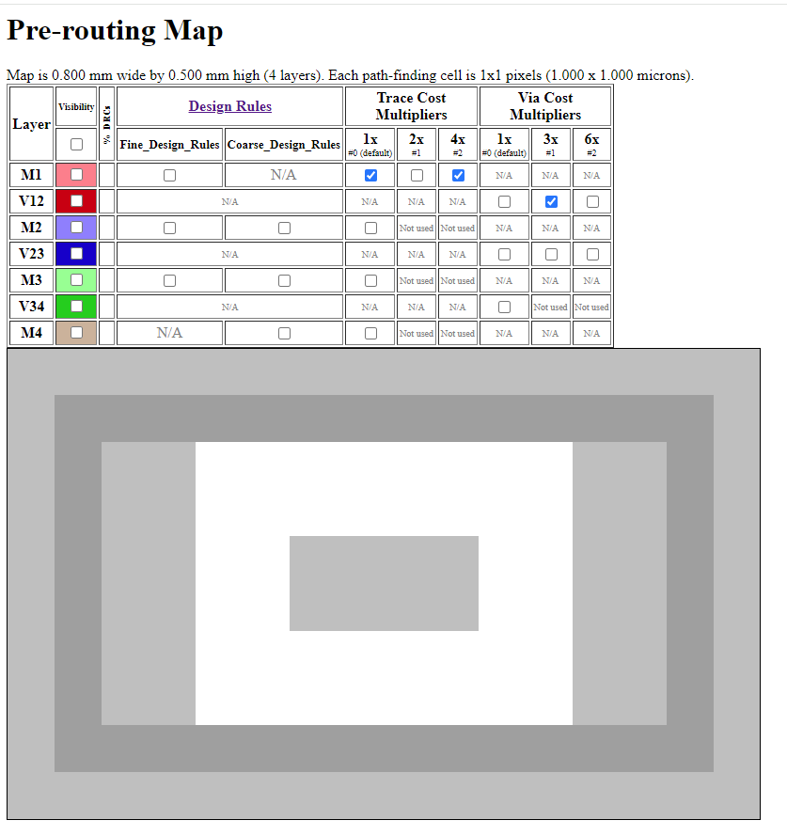
Toggle the visibility of zones with higher routing costs.
All layers are overlaid in this routing area

Slide 9
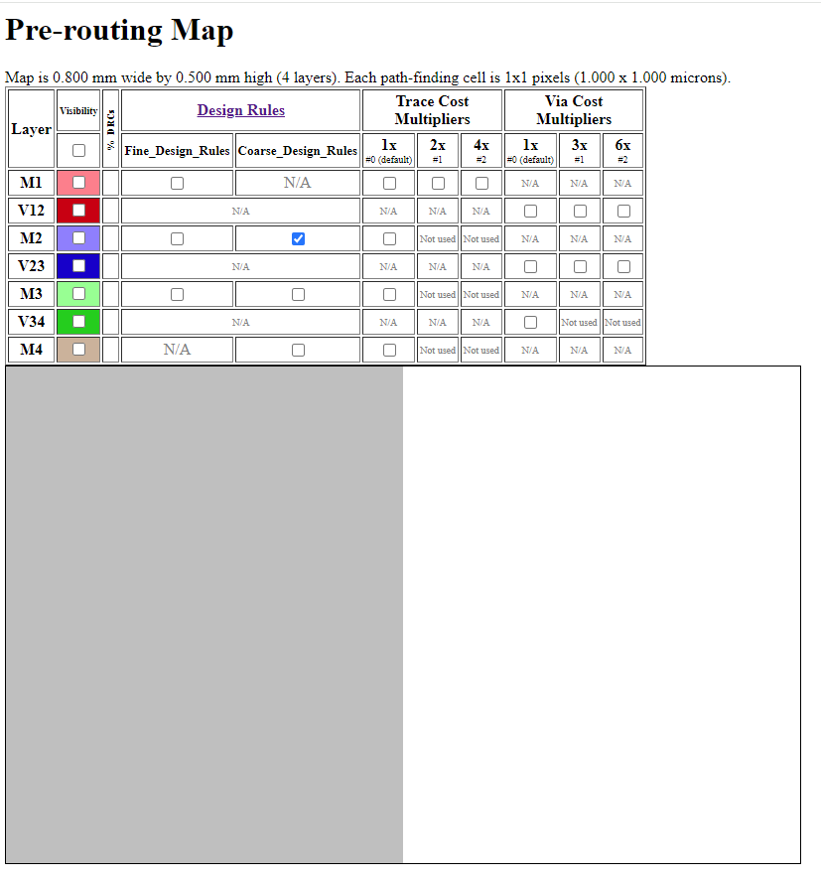
All layers are overlaid in this routing area
Toggle the visibility of zones with different design rules

Slide 10
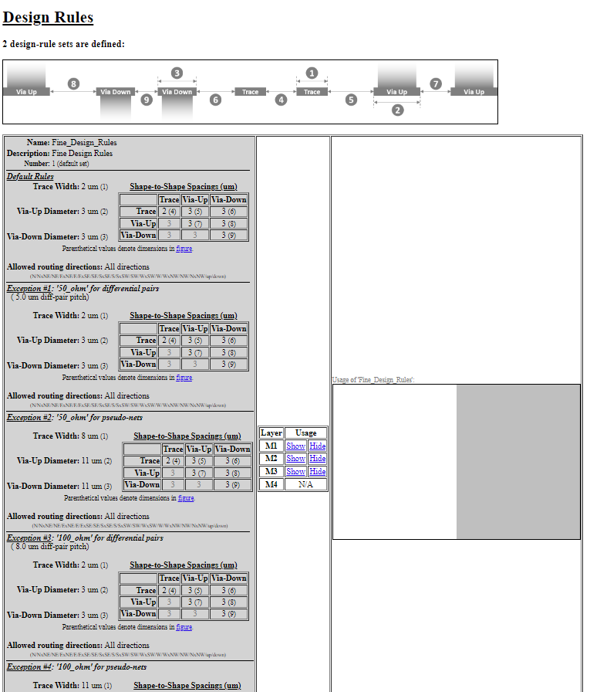
Legend for 9 design-rule parameters
Width and spacing values for each design-rule zone
Design-rule zone shown in routing area
Toggle the visibility of each design-rule zone.

Slide 11
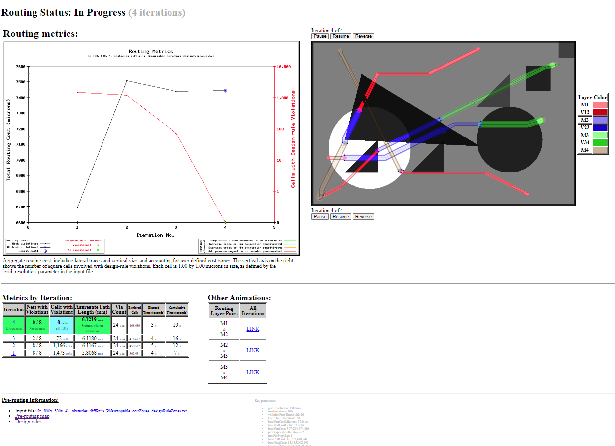
Current status of Acorn run
Nets shown in routing area with all layers overlaid, animated across iterations
Design-rule violations vs. iteration
Routing cost vs. iteration
Legend for routing layers
Links to animations of adjacent layers
Hyperlinks to detailed routing for each iteration
Routing metrics for each iteration

Slide 12
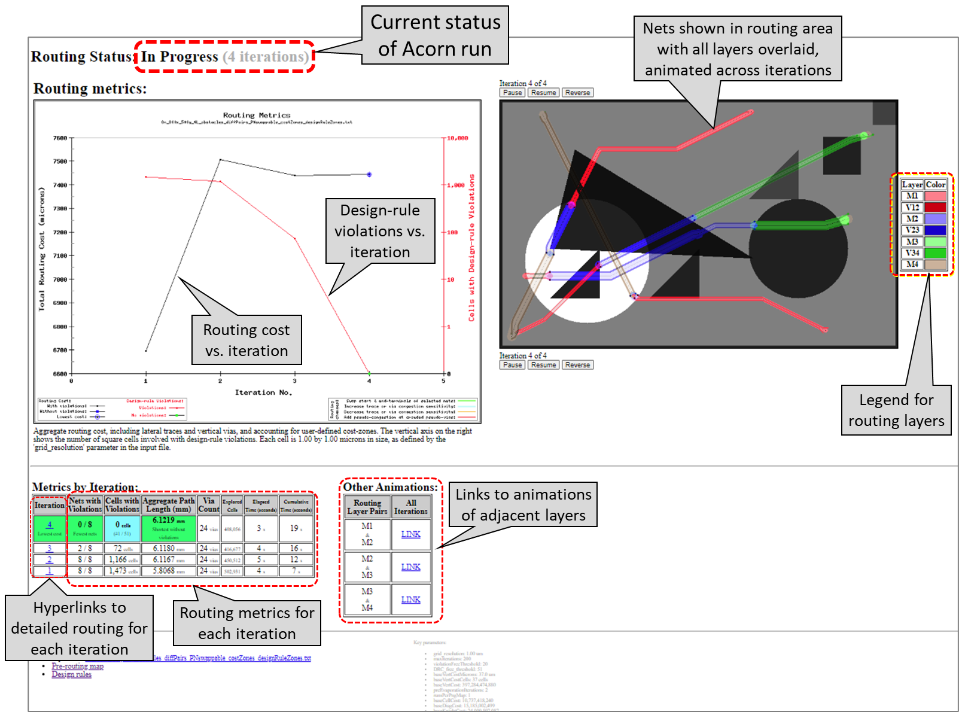

Slide 13
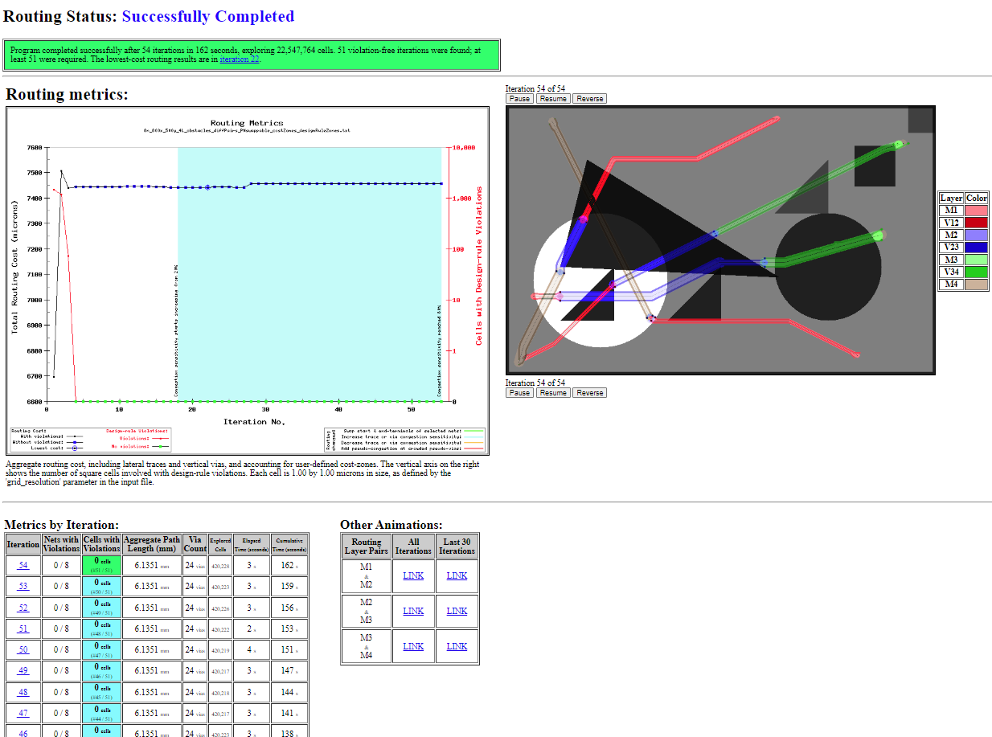
Status of completed Acorn run
Summary of completed Acorn run
Routing metrics vs. iteration
Nets shown in routing area with all layers overlaid, animated across iterations
Legend for routing layers
Hyperlinks to detailed routing for each iteration
Links to animations of adjacent layers
Routing metrics for each iteration

Slide 14
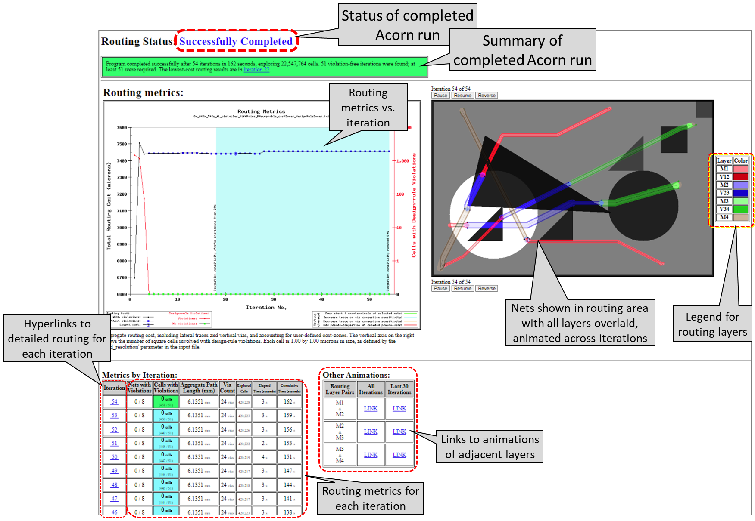

Slide 15
Start
Terminal
End
Terminal
Barrier
M1
M2

Slide 16
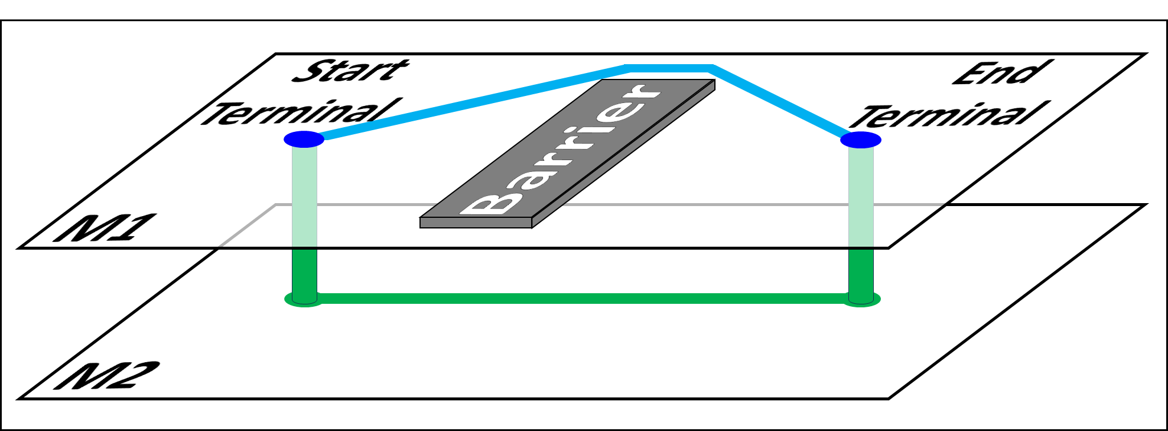

Slide 17
Images for Manuscript

Slide 18
Problem Scope

Slide 19
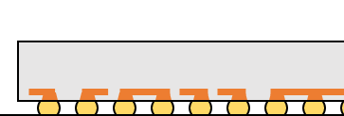
Redistribution layer(s) on die
Routing layers on
flip-chip package
PCB
routing

Slide 20
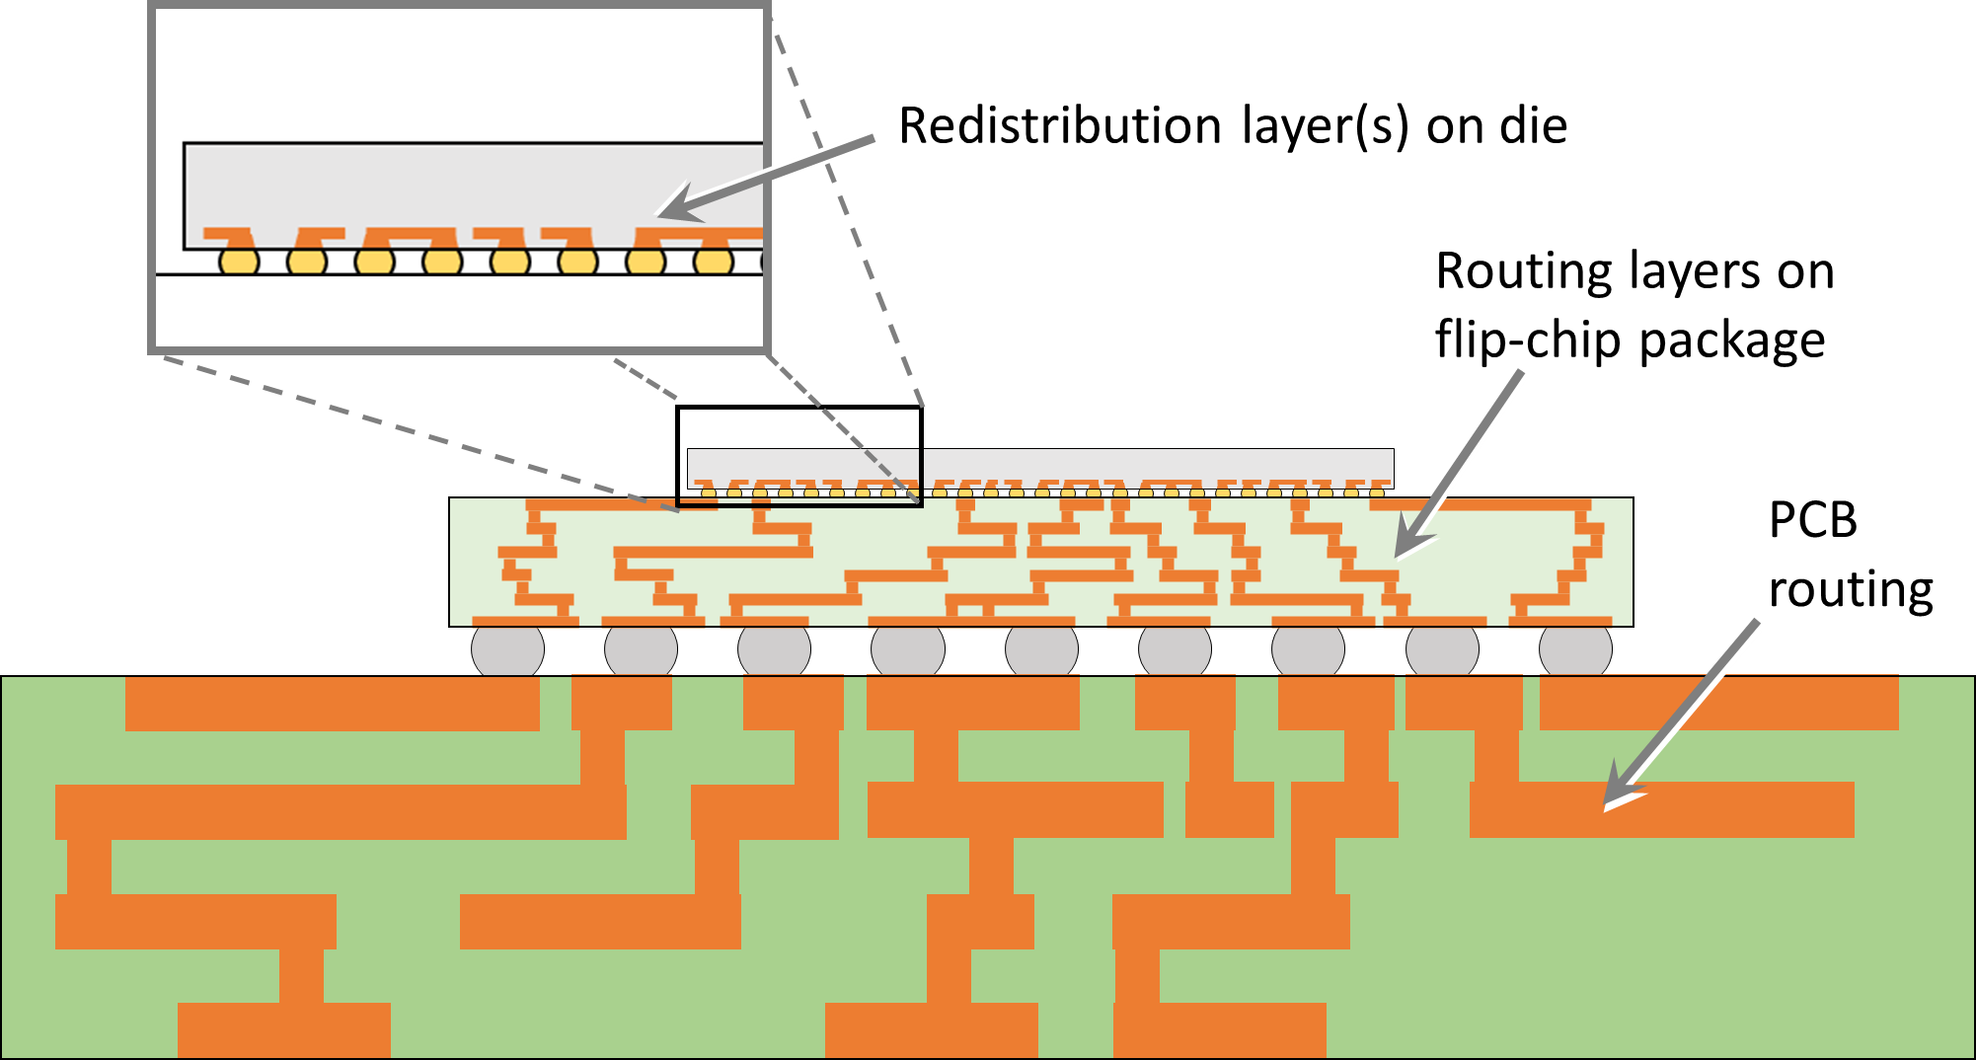

Slide 21
Routing Layers and Boundaries

Slide 22
a.
Boundaries for die-to-package vias
Boundaries for package-to-PCB vias
y
x
Boundaries for routing layer on dies
Boundaries for package routing layers
Boundaries for PCB routing layers
Die
#1
Die
#2
Die
#3
Package
#1
Package
#2
b.
Layers shown are routing layers, and should not be confused with laminate layers, each of which can contain multiple routing layers.
Die
#1
Die
#2
Die
#3
y
Package #1
Package #2
There is no restriction that each die (or package) must have the same number of routing layers as other die (packages) on the PCB.
x
PCB
z

Slide 23
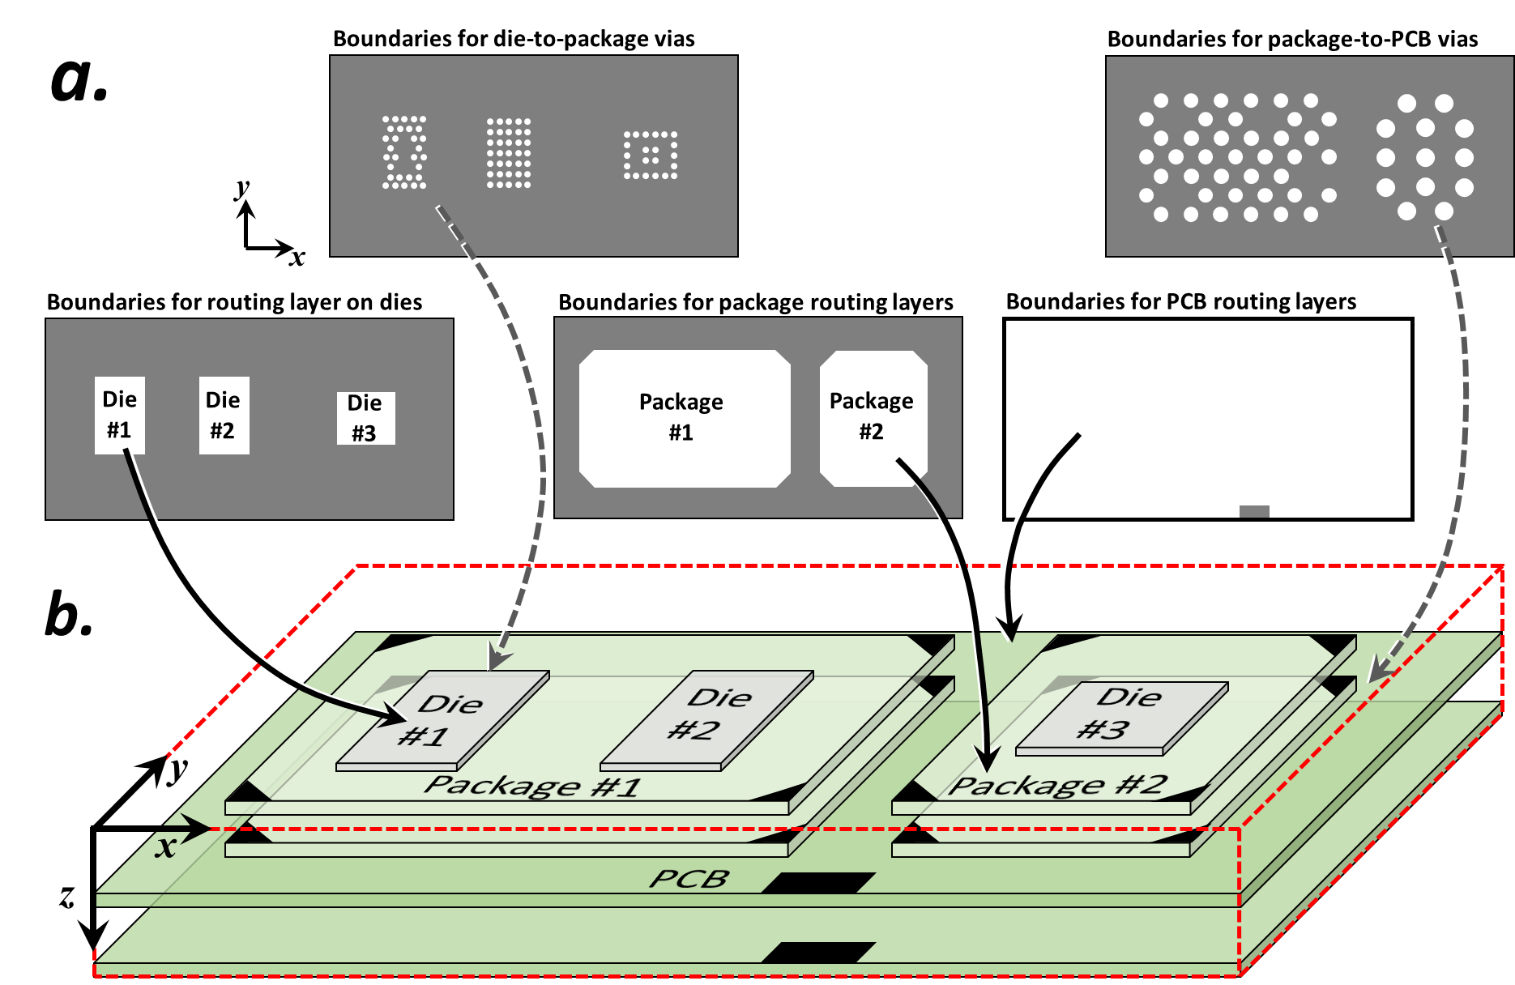

Slide 24
Boundaries for die-to-package vias
Boundaries for package-to-PCB vias
y
x
Boundaries for routing layer on dies
Boundaries for package routing layers
Boundaries for PCB routing layers
Die
#1
Die
#2
Die
#3
Package
#1
Package
#2
Die
#1
Die
#2
Die
#3
y
Package #1
Package #2
x
PCB
z

Slide 25
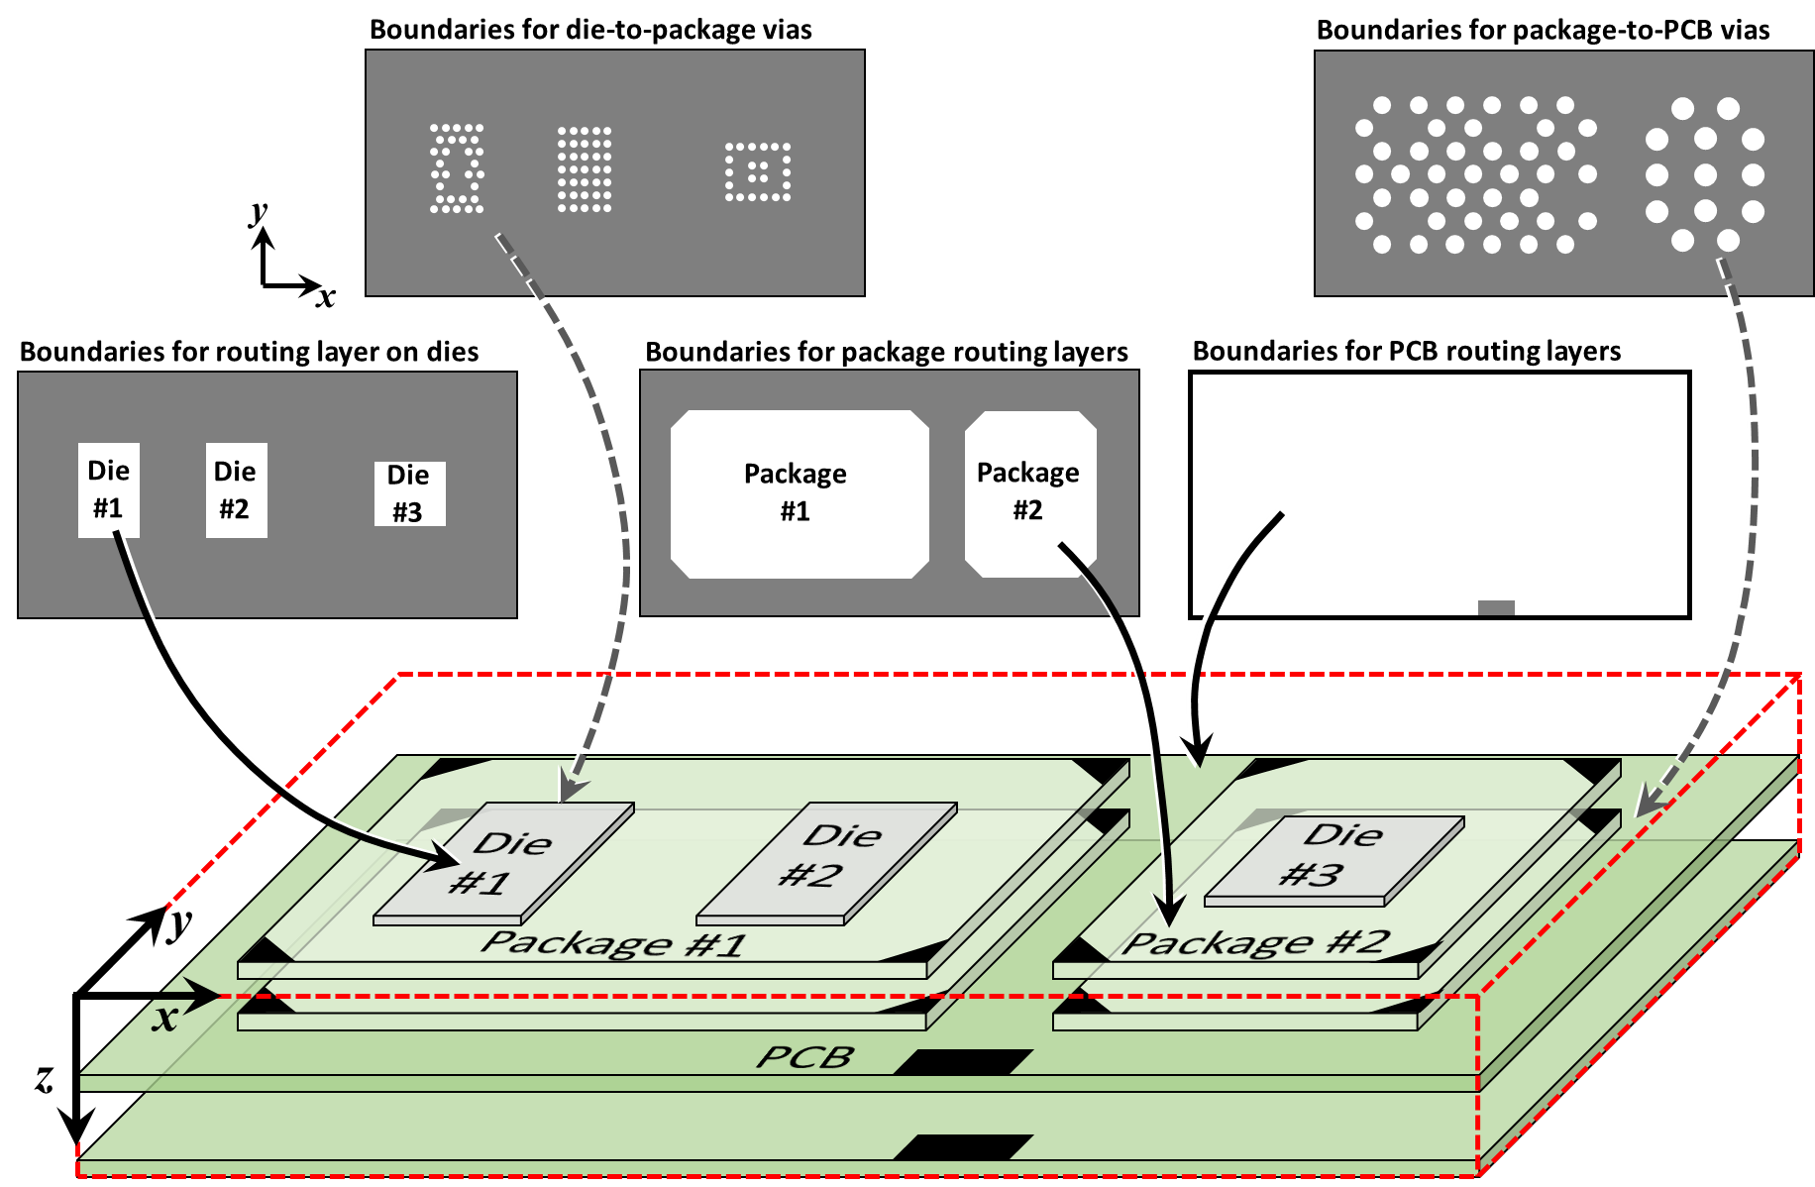

Slide 26
Die
#1
Die
#2
Die
#3
y
Package #1
Package #2
x
PCB
z

Slide 27
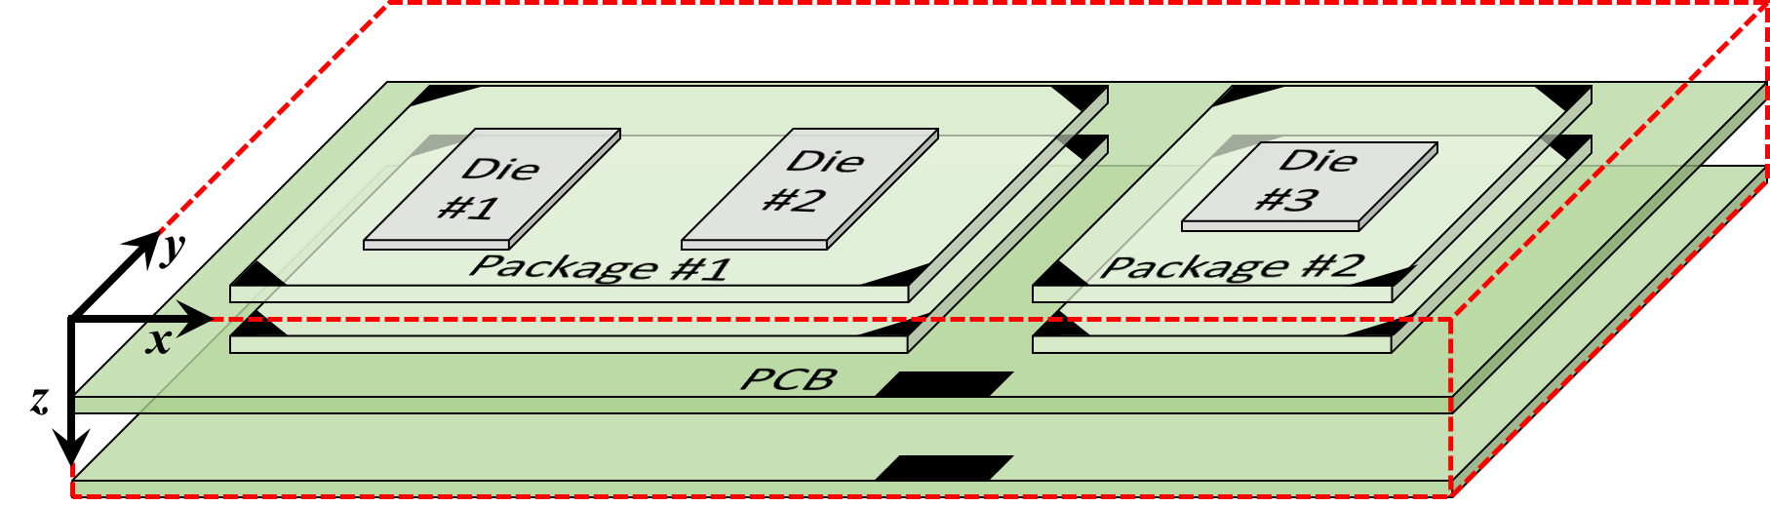

Slide 28
Boundaries for routing layer on dies
Die
#1
Die
#2
Die
#3
y
x
Die
#1
Die
#2
Die
#3
y
Package #1
Package #2
x
PCB
z

Slide 29
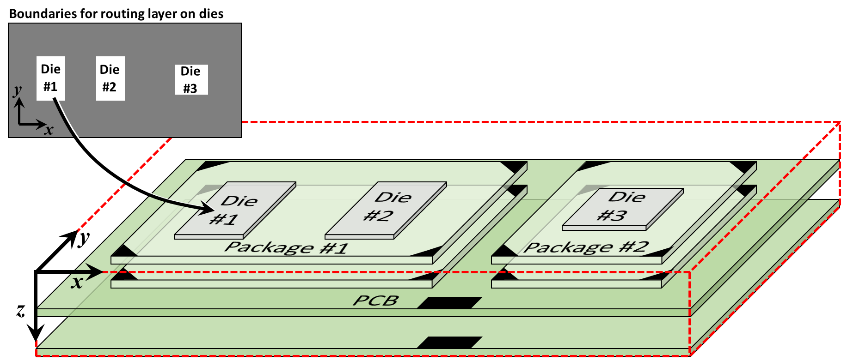

Slide 30
Boundaries for package routing layers
Package
#1
Package
#2
y
x
Die
#1
Die
#2
Die
#3
y
Package #1
Package #2
x
PCB
z

Slide 31
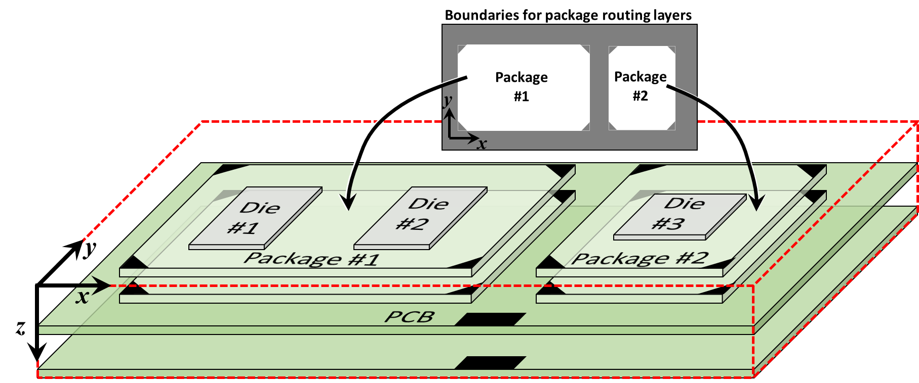

Slide 32
Boundaries for die-to-package vias
Boundaries for package-to-PCB vias
y
y
x
x
Die
#1
Die
#2
Die
#3
y
Package #1
Package #2
x
PCB
z

Slide 33
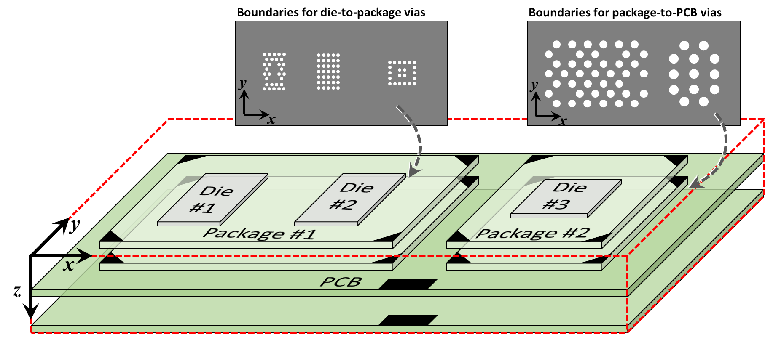

Slide 34
Routing Design Rules

Slide 35
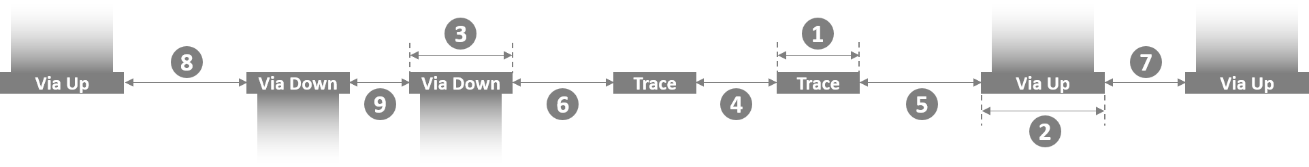

Slide 36
Pin Swapping

Slide 37
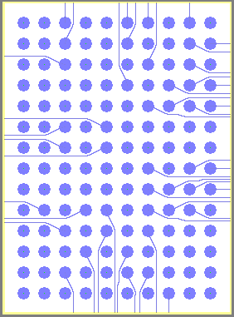
a.
b.
Two pin-swap zones
RAM
8 swap-
pable
terminals
8 swap-
pable
terminals
Non-swappable terminals
Lower-left corner of pin-swap zone
(yellow) contains terminals of all nets.

Slide 38
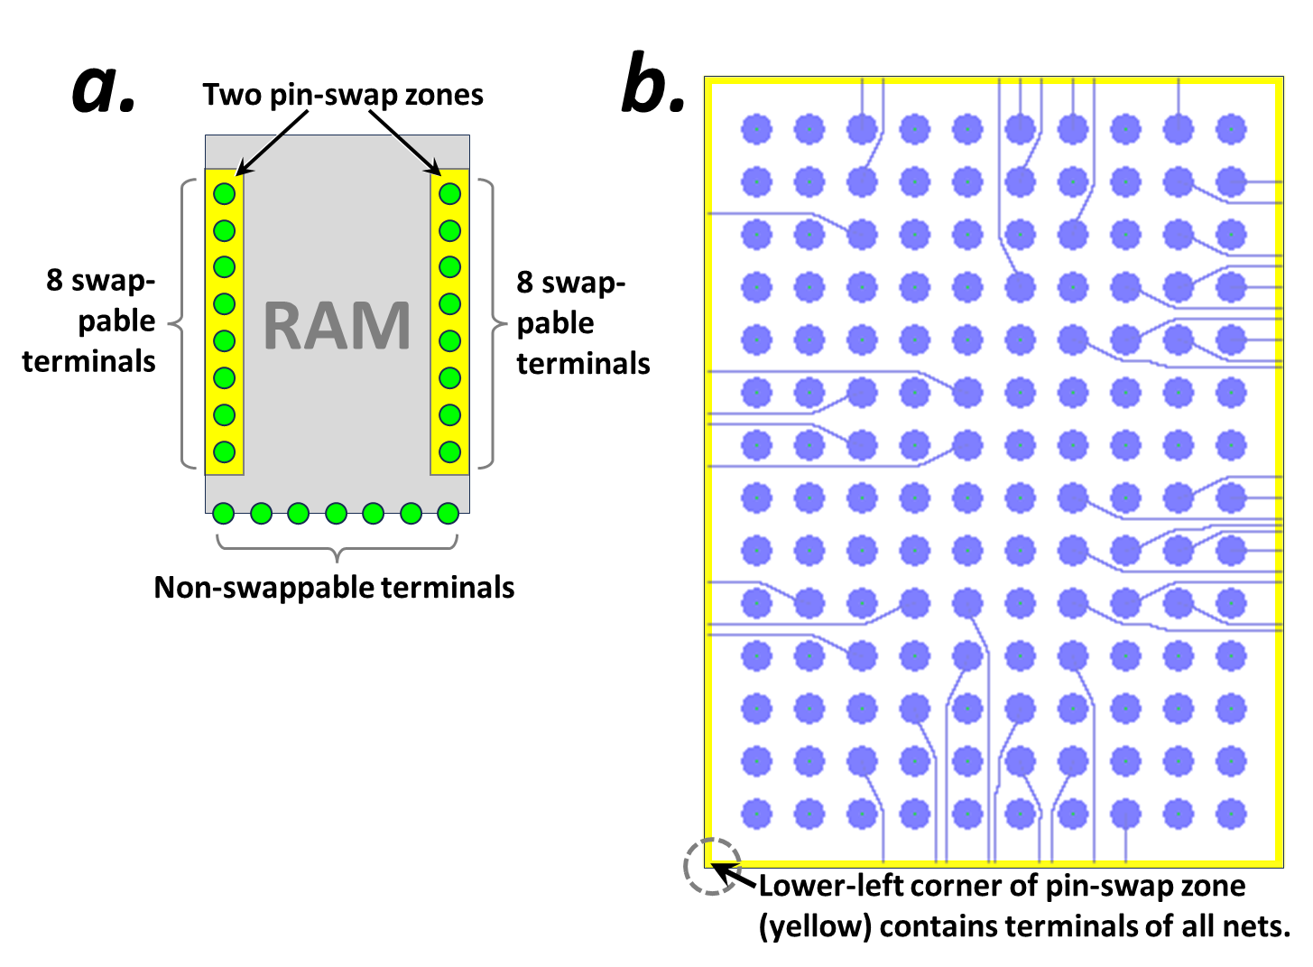

Slide 39
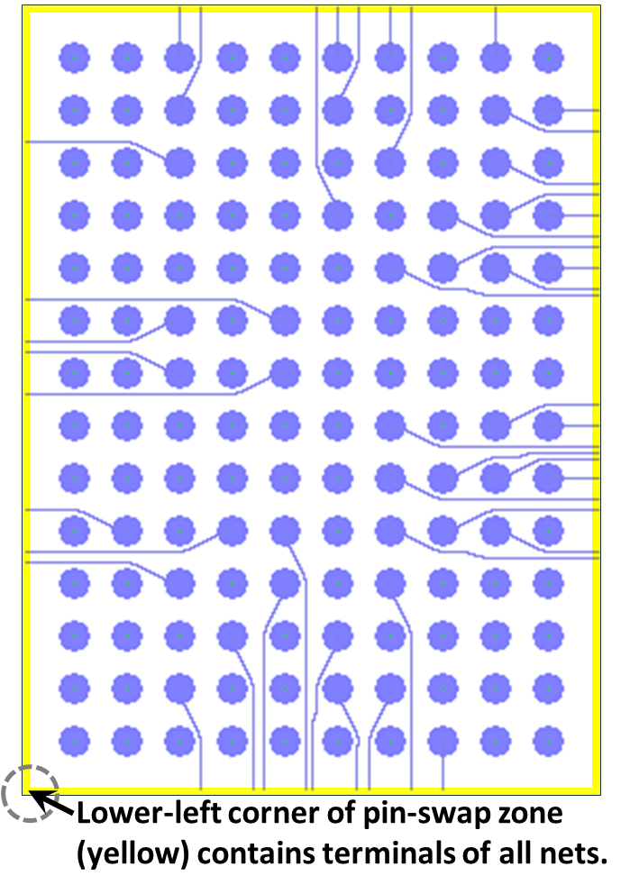
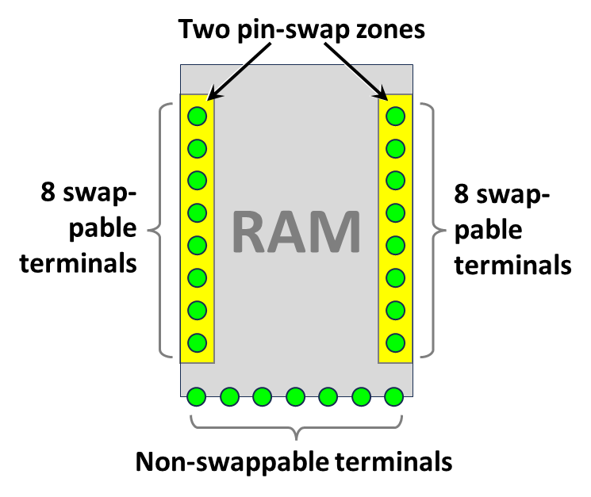

Slide 40
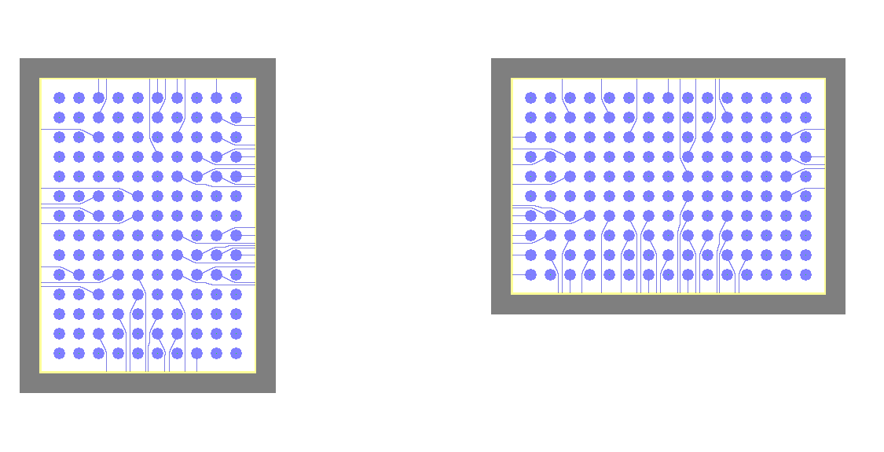
\\wsl.localhost\Ubuntu\home\boyne\autorouter\REGRESSION_TESTING--c7g.4xlarge--5Jul2024\90n_45mmX23mm_1L_twoSingleComponentEscapeRouting_40umRes\map_iter0146_02_ROUTING.png

Slide 41
Escape Routing

Slide 42
Die
Package
Single pin-swap zone along base of package
(yellow) contains terminals of all nets.

Slide 43
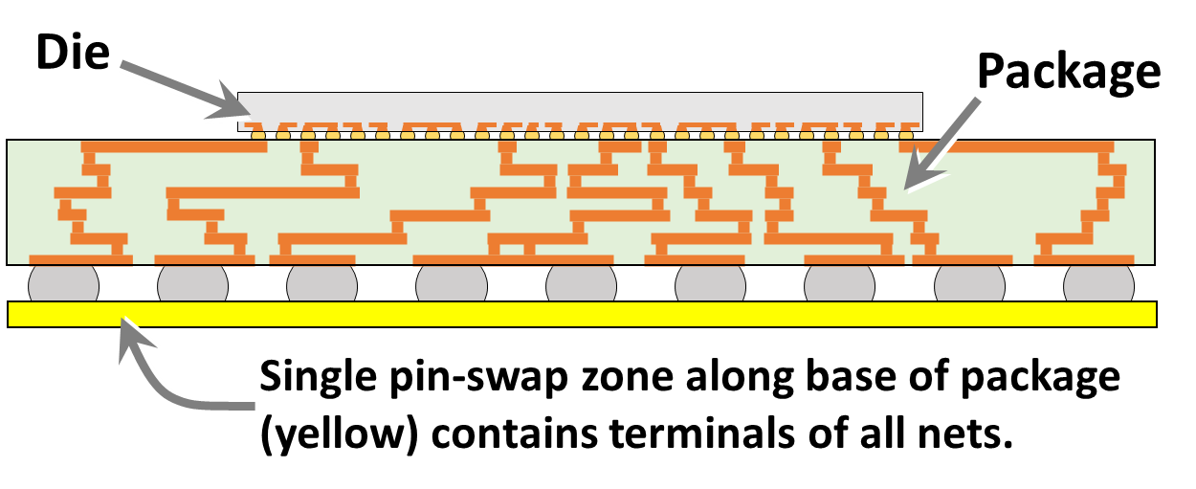

Slide 44
Single pin-swap zone along perimeter of PCB
(yellow) contains terminals of all nets.
Die
Package
PCB

Slide 45
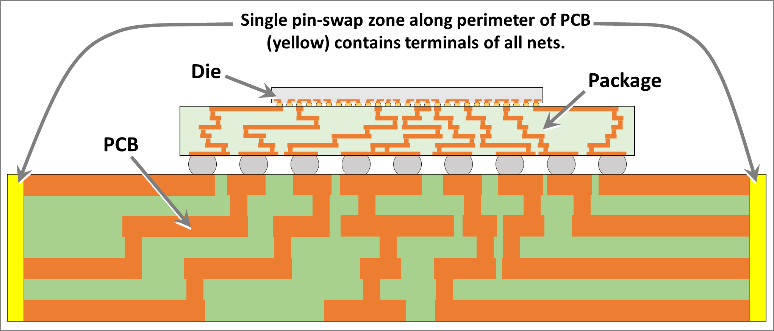

Slide 46
a.
Die
Package
Single pin-swap zone along base of package (yellow) contains terminals of all nets.
b.
Single pin-swap zone along perimeter of PCB
(yellow) contains terminals of all nets.
Die
Package
PCB

Slide 47
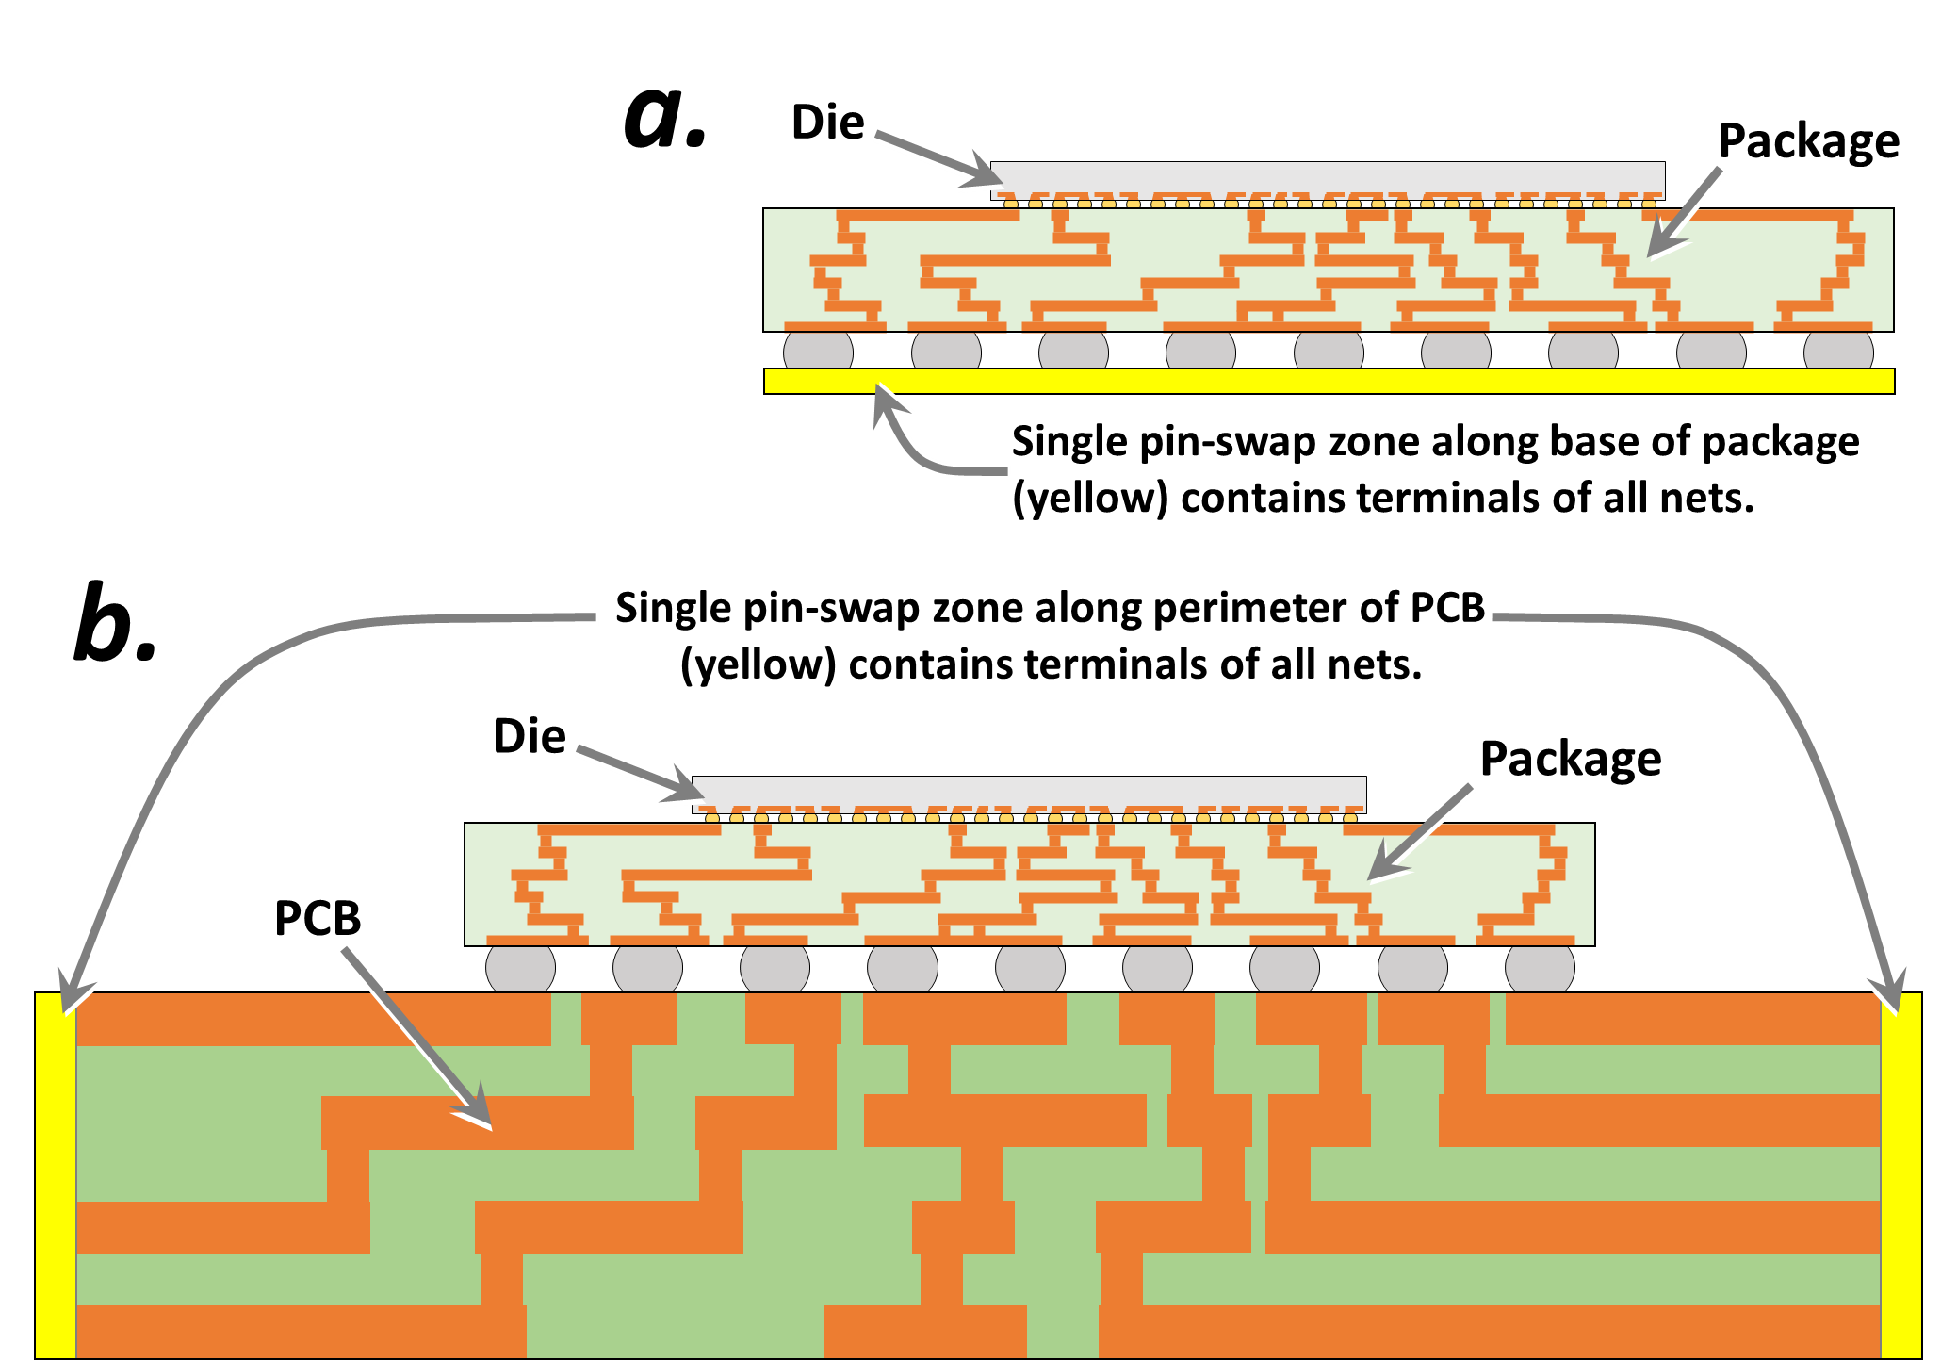

Slide 48
Cost Zones

Slide 49

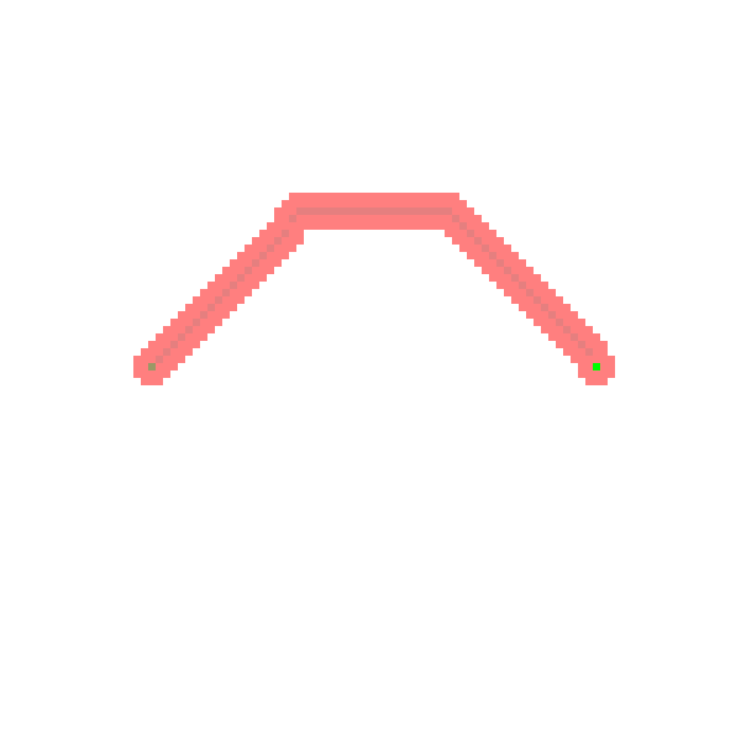

Trace
Direct trace
Start
Terminal
End
Terminal
Start
Terminal
Zone with
2X higher
trace cost
End
Terminal

Slide 50
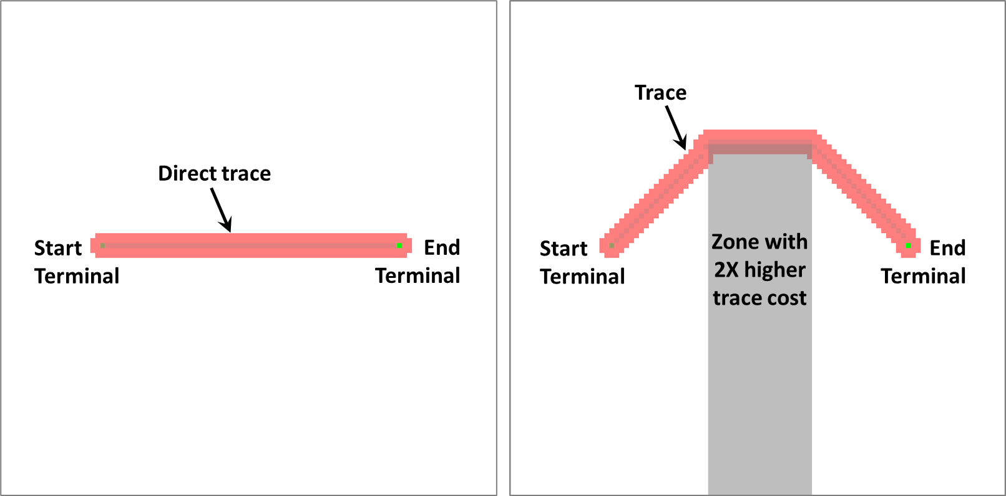

Slide 51
Algorithm

Slide 52
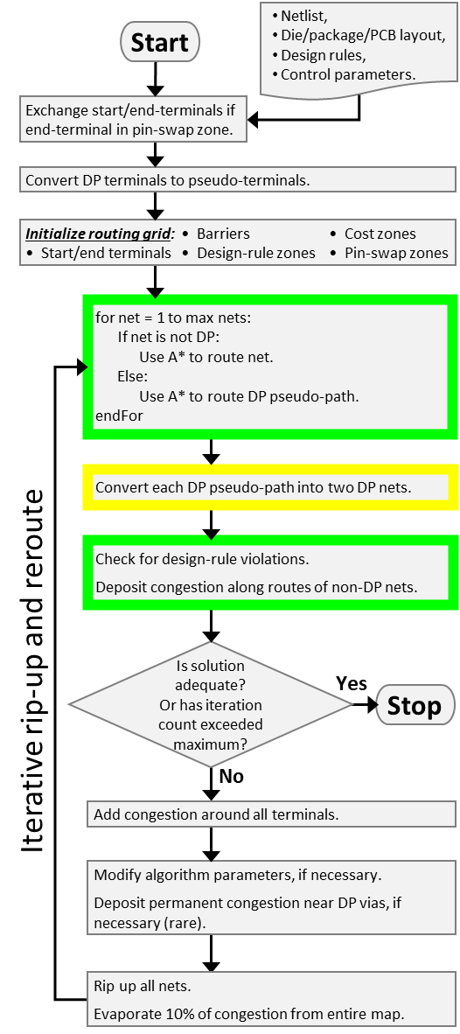
Netlist,
Die/package/PCB layout,
Design rules,
Control parameters.
Start
Exchange start/end-terminals if end-terminal in pin-swap zone.
Convert DP terminals to pseudo-terminals.
Initialize routing grid: • Barriers • Cost zones
• Start/end terminals • Design-rule zones • Pin-swap zones
for net = 1 to max nets:
If net is not DP:
Use A* to route net.
Else:
Use A* to route DP pseudo-path.
endFor
Convert each DP pseudo-path into two DP nets.
Check for design-rule violations.
Deposit congestion along routes of non-DP nets.
Is solution adequate?
Or has iteration count exceeded maximum?
Iterative rip-up and reroute
Yes
Stop
No
Add congestion around all terminals.
Modify algorithm parameters, if necessary.
Deposit permanent congestion near DP vias, if necessary (rare).
Rip up all nets.
Evaporate 10% of congestion from entire map.

Slide 53
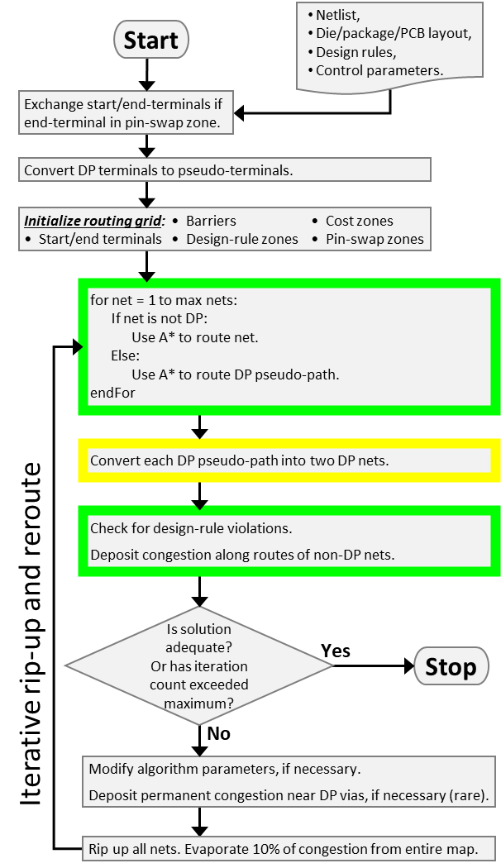
Netlist,
Die/package/PCB layout,
Design rules,
Control parameters.
Start
Exchange start/end-terminals if end-terminal in pin-swap zone.
Convert DP terminals to pseudo-terminals.
Initialize routing grid: • Barriers • Cost zones
• Start/end terminals • Design-rule zones • Pin-swap zones
for net = 1 to max nets:
If net is not DP:
Use A* to route net.
Else:
Use A* to route DP pseudo-path.
endFor
Convert each DP pseudo-path into two DP nets.
Check for design-rule violations.
Deposit congestion along routes of non-DP nets.
Is solution adequate?
Or has iteration count exceeded maximum?
Iterative rip-up and reroute
Yes
Stop
No
Modify algorithm parameters, if necessary.
Deposit permanent congestion near DP vias, if necessary (rare).
Rip up all nets. Evaporate 10% of congestion from entire map.

Slide 54
Is connection on 1 layer?
Try a simple, geometric-based heuristic to optimize wiring configuration.
Start
Yes
No
Does geometric heuristic provide conclusive answer?
Sample the previous congestion around the connection's 4 terminals.
No
Does previous congestion unambiguously reveal previous wiring configuration?
Yes
No
Run compute-intensive optimation and assign 'swap' value based thereon.
Assign 'swap' value based on geometric heuristic.
Yes
Do diff-pair paths have DRCs on previous iterations?
Yes
Assign 'swap' value based on previous congestion.
End
No

Slide 55
Start
Compare FC_{NS} & FC_{S}
NS > S
NS < S
NS ≈ S
Compare DRC_{NS} & DRC_{S}
NS > S
NS < S
NS ≈ S
Compare GDIST_{NS} & GDIST_{S}
NS > S
NS < S
NS ≈ S
Compare G_{NS} & G_{S}
NS > S
NS < S
NS ≈ S
Compare DIST_{NS} & DIST_{S}
NS > S
NS < S
NS ≈ S
Swap connections
Don't swap connections
End

Slide 56
Auto-router algorithm flow-chart 23 Jan 2018
Key variable: evaporation rate
Start
pathFinderRun = 1 ?
N
optimizationRun
= TRUE ?
N
evaporateCongestion
Y
Y
pathFinderRun++
pathNum = 0
solutionFound = FALSE
optimizationRun = FALSE
pathFinderRun = 0
samePathBenefit = 1
Y
Run the findPath routine on path #pathNum
N
pathNum
< numPaths ?
Increment pathNum
pathFinderRun < maxIterations ?
solutionFound = TRUE ?
N
Y
createContiguousPath
N
Y
optimizationRun = TRUE ?
calcRoutabilityMetrics
Y
update_congestion_map
Adds congestion from latest pathfinder runs
N
num_crossings = 0 ?
Y
N
Key variable: how many zero-crossing solutions before solution is ‘good’?
Stop
Was good solution found ?
Y
N
Y
optimization_run = TRUE ?
optimization_run = FALSE
N
optimization_run = TRUE
samePathBenefit = 0
clearUnsuccessfulCongestion

Slide 57
Routing Grid Definition (allowed directions)

Slide 58
ORIGINAL

Slide 59
All

Slide 60
All

Slide 61
None

Slide 62
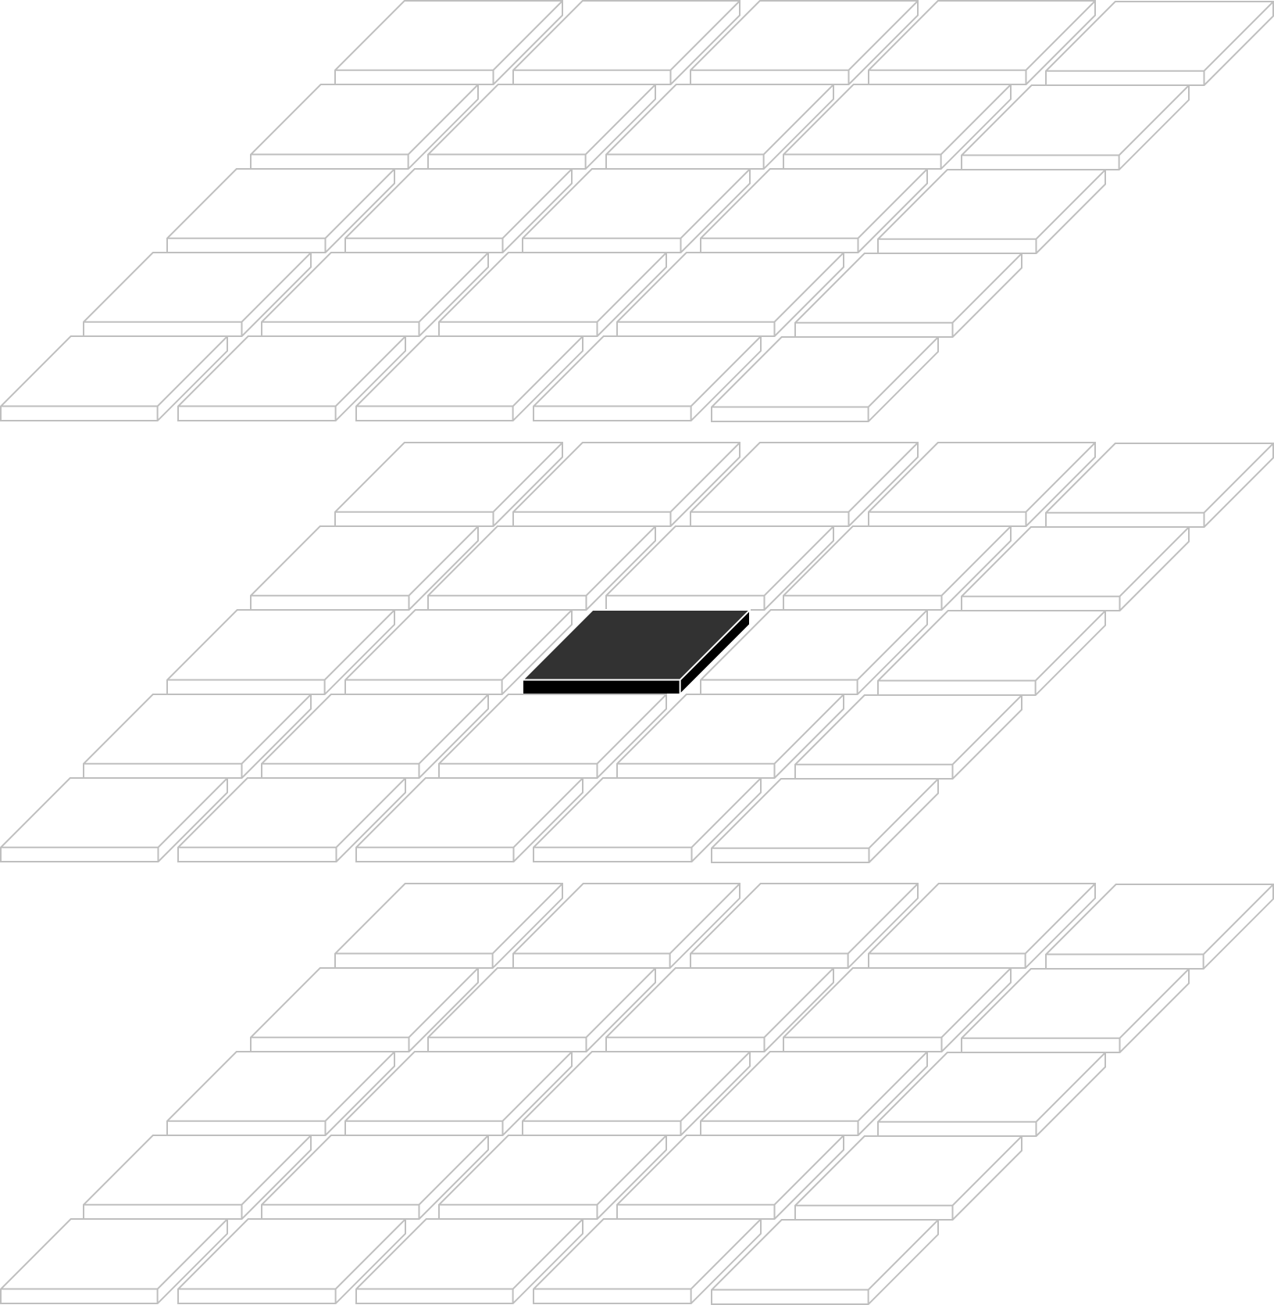
None

Slide 63
Manhattan

Slide 64
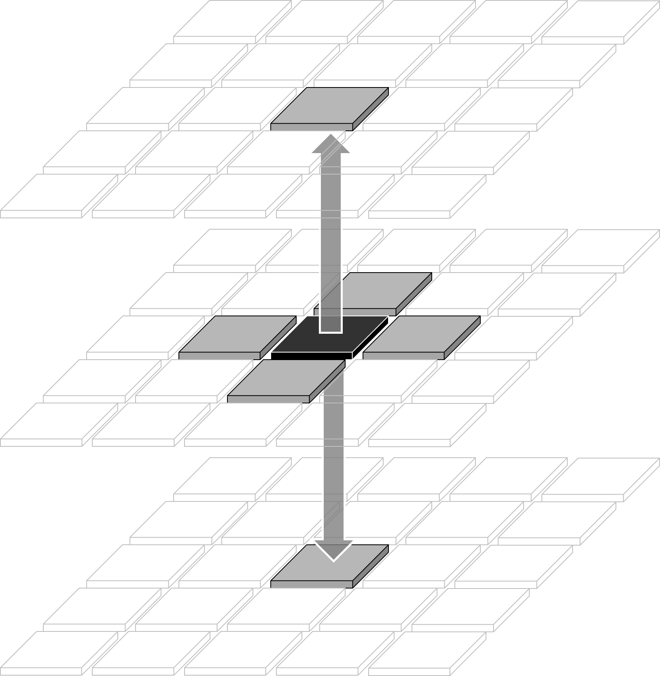
Manhattan

Slide 65
X_Routing

Slide 66
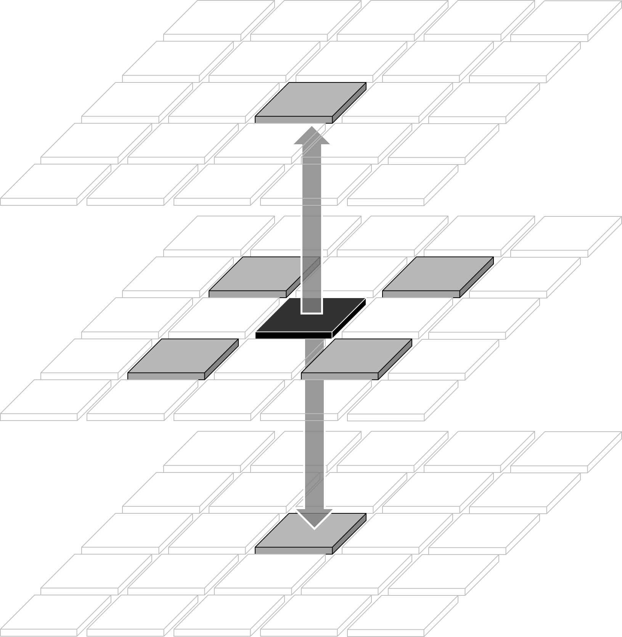
X_Routing

Slide 67
North_South

Slide 68
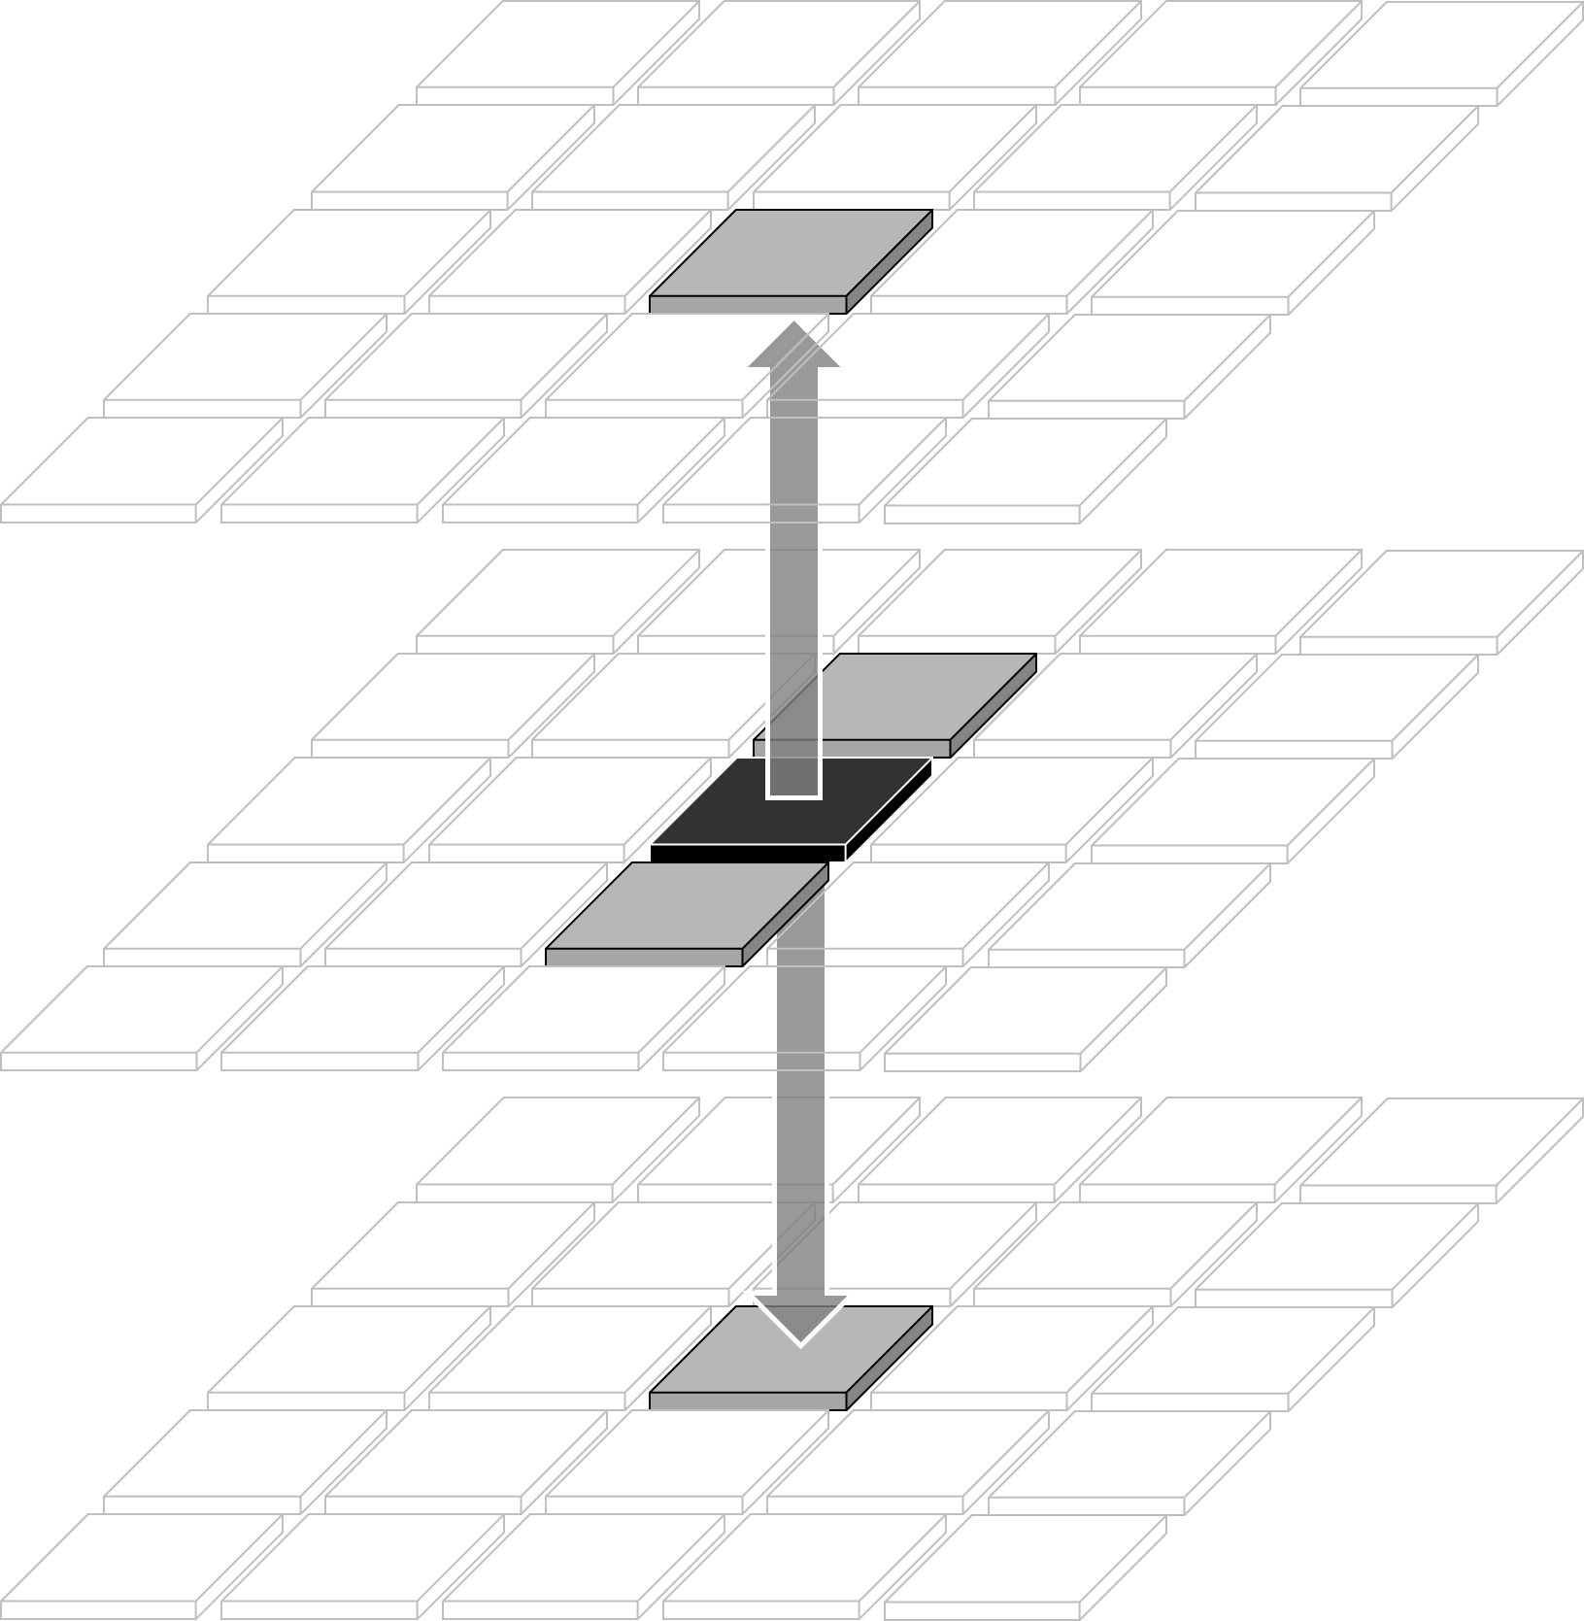
North_South

Slide 69
East_West

Slide 70
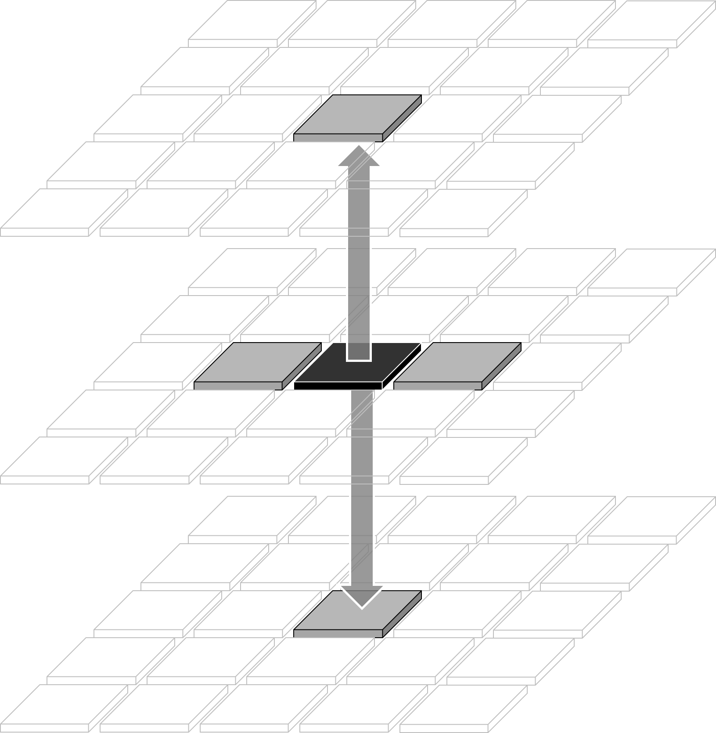
East_West

Slide 71
Manhattan_X

Slide 72
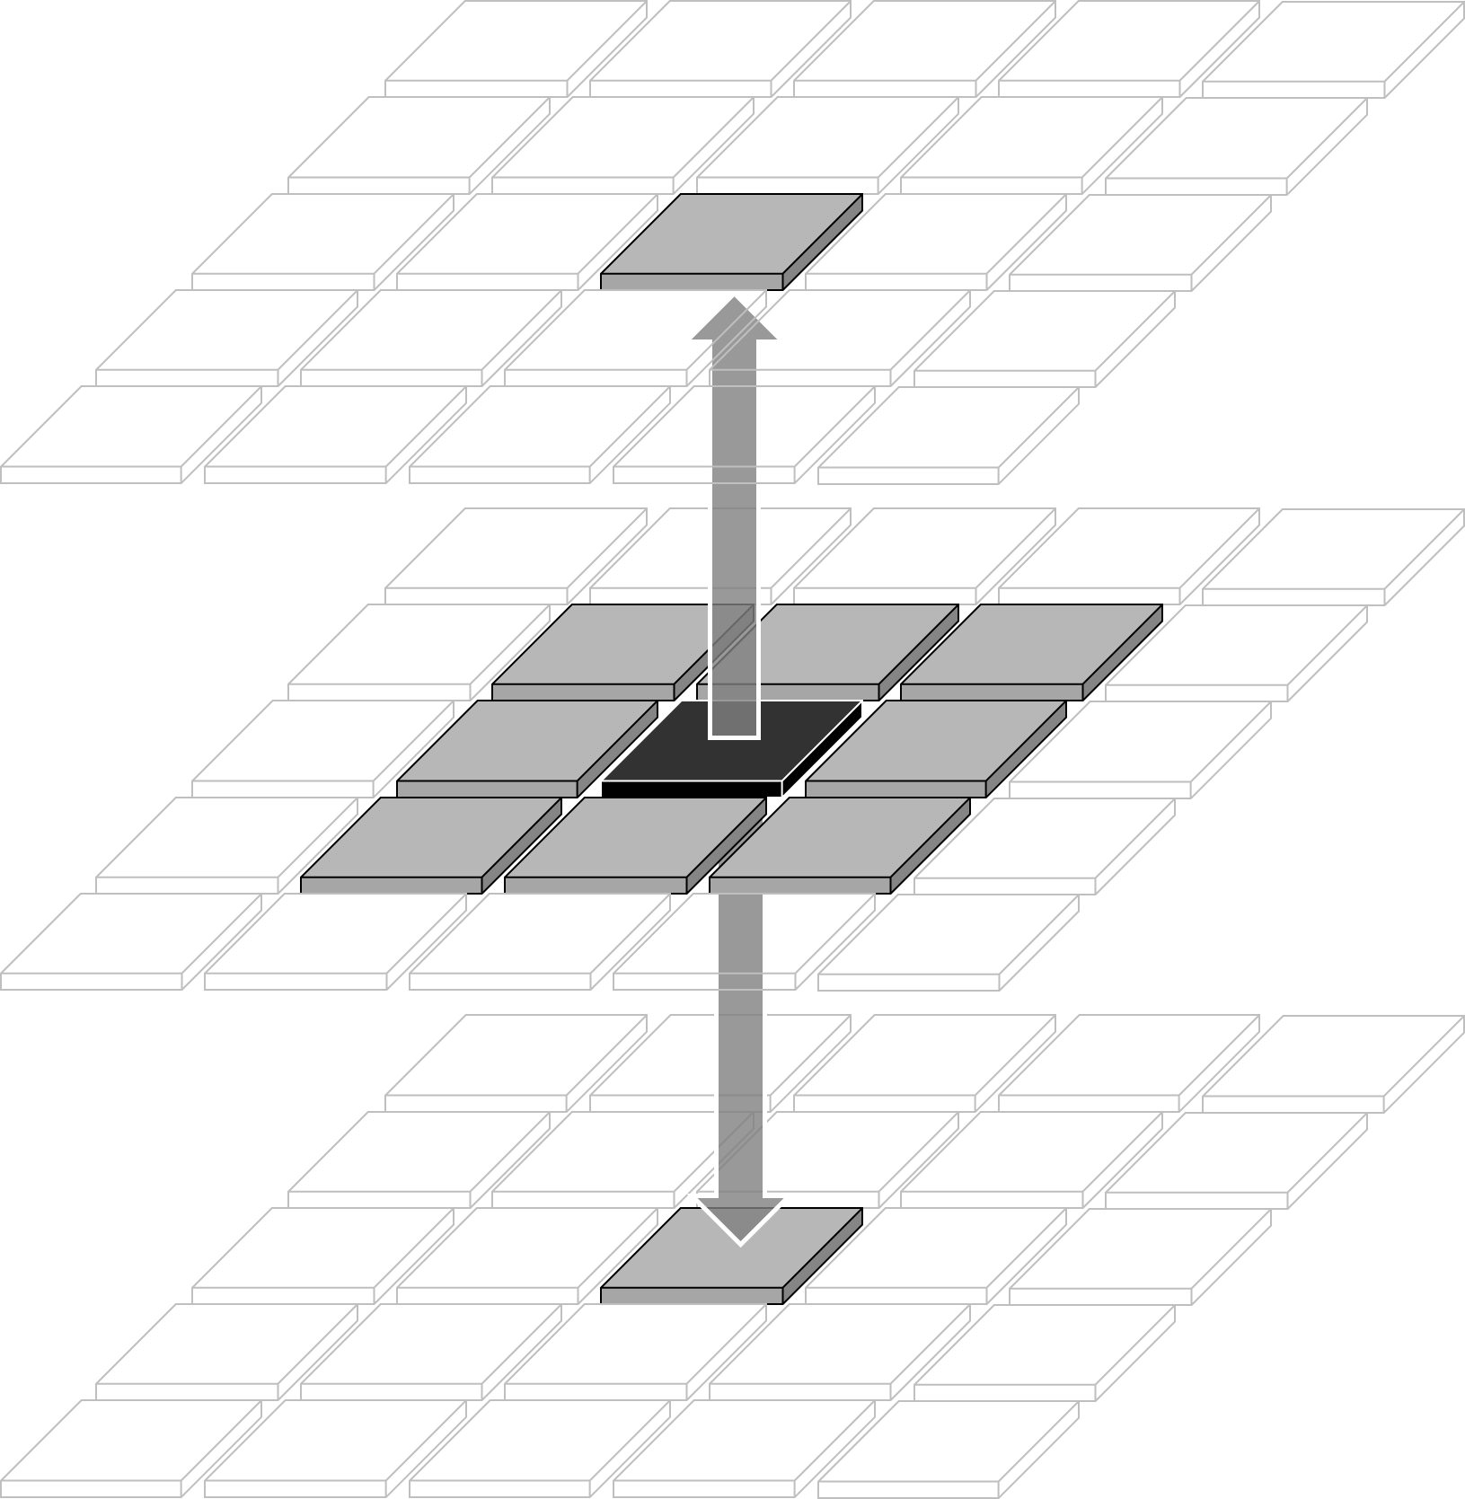
Manhattan_X

Slide 73
Up_Down

Slide 74
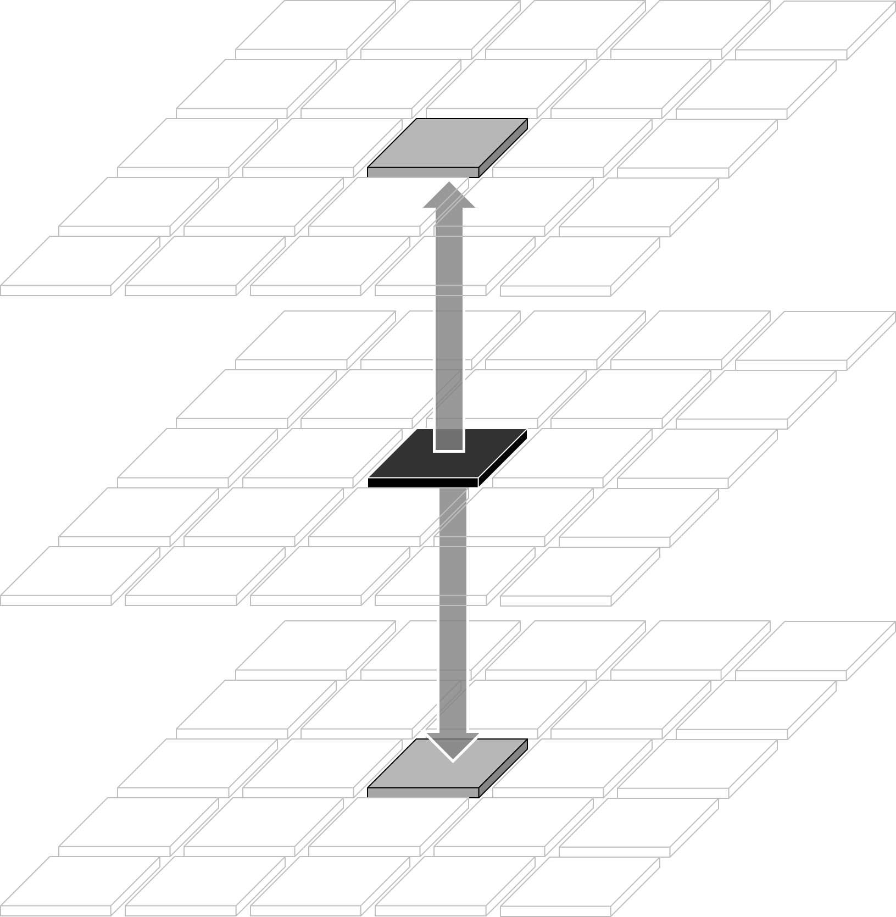
Up_Down

Slide 75
Any_Lateral

Slide 76
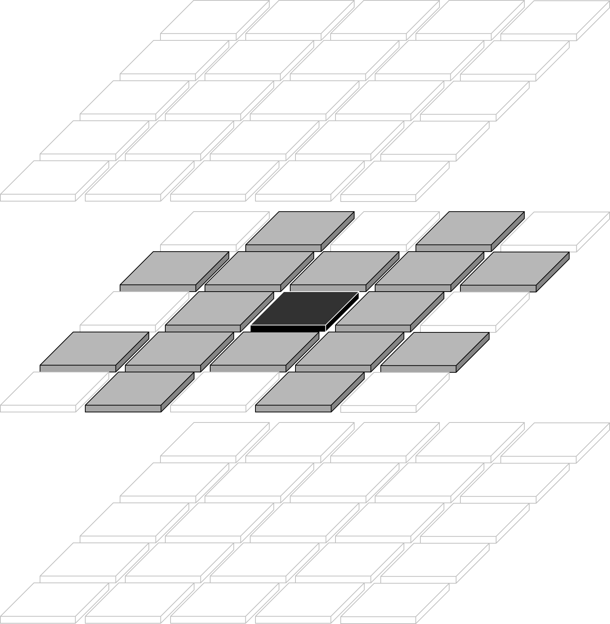
Any_Lateral

Slide 77
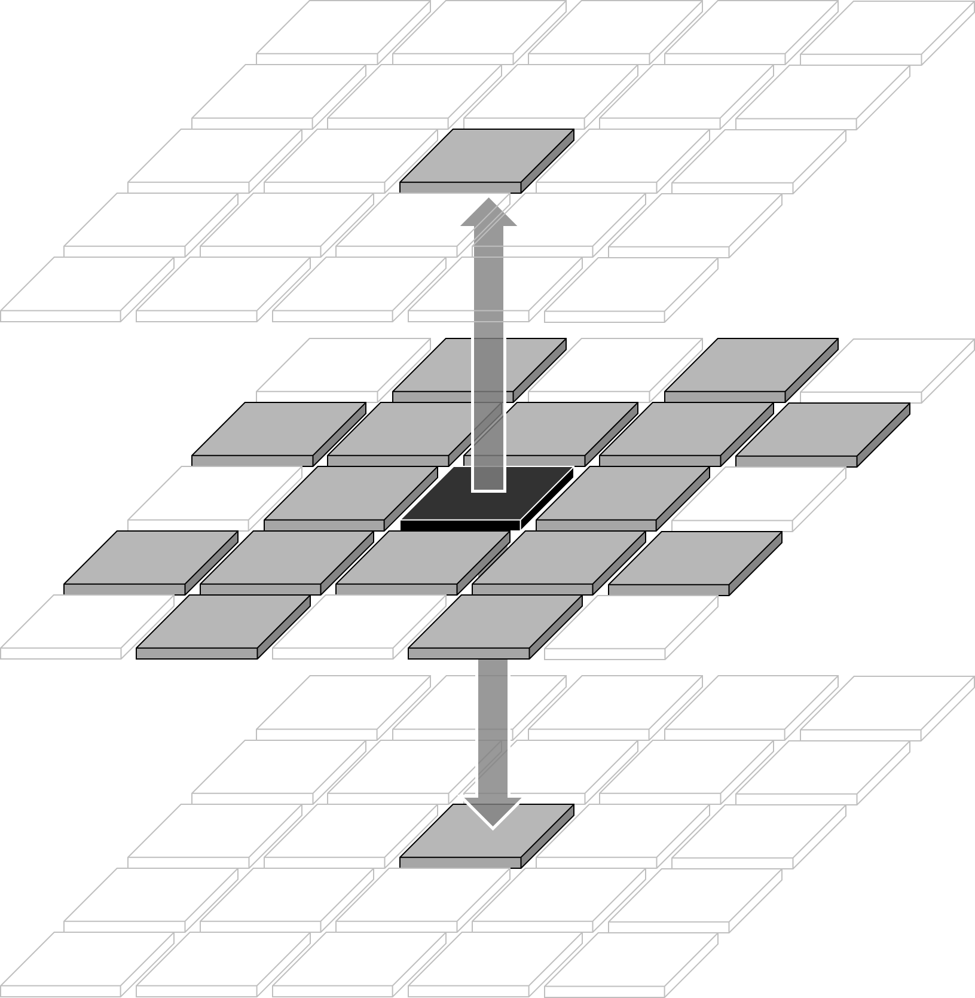

Slide 78
Congestion Deposition

Slide 80

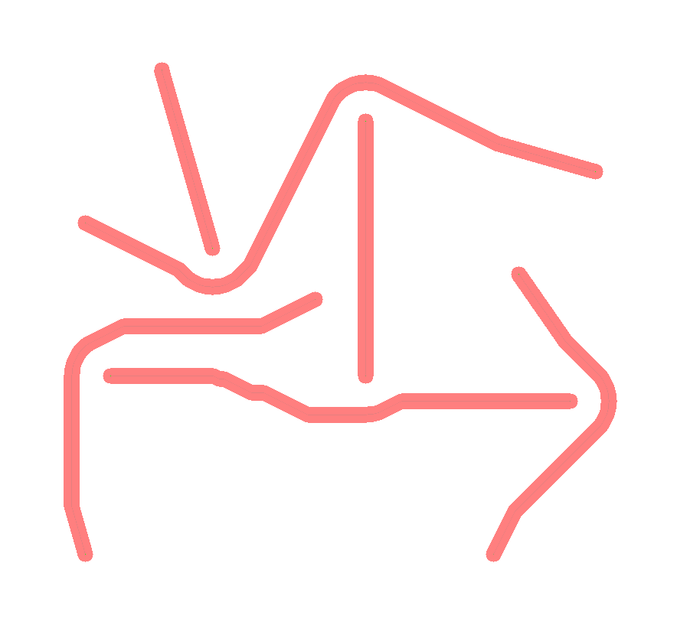
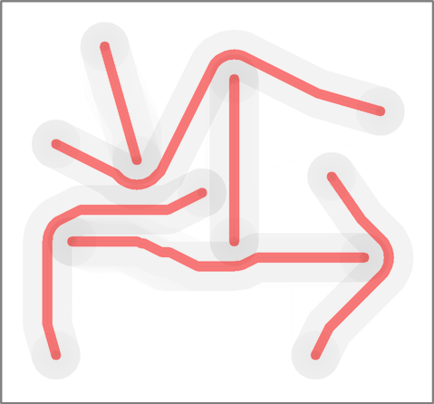

Slide 82










Slide 83
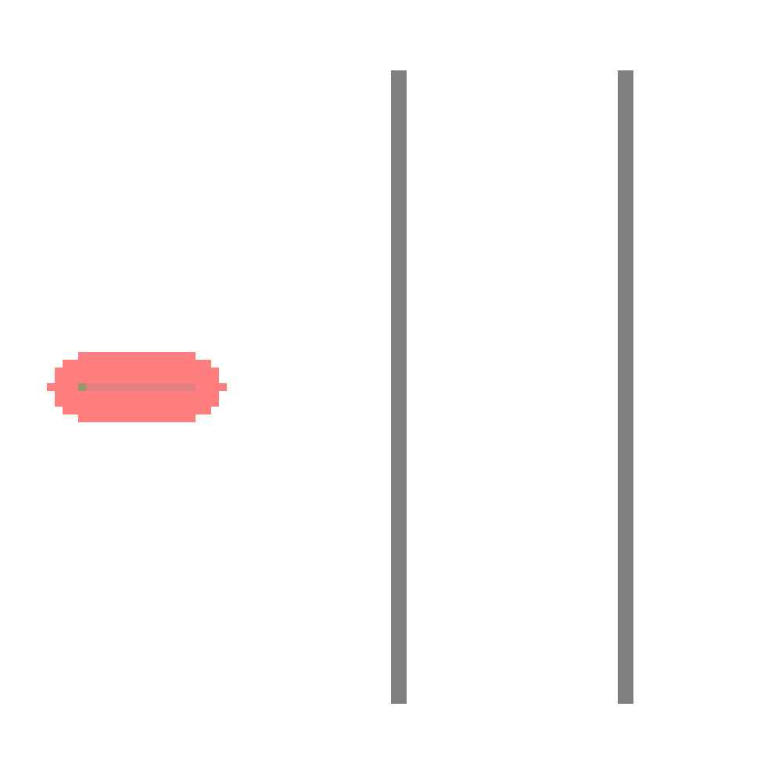
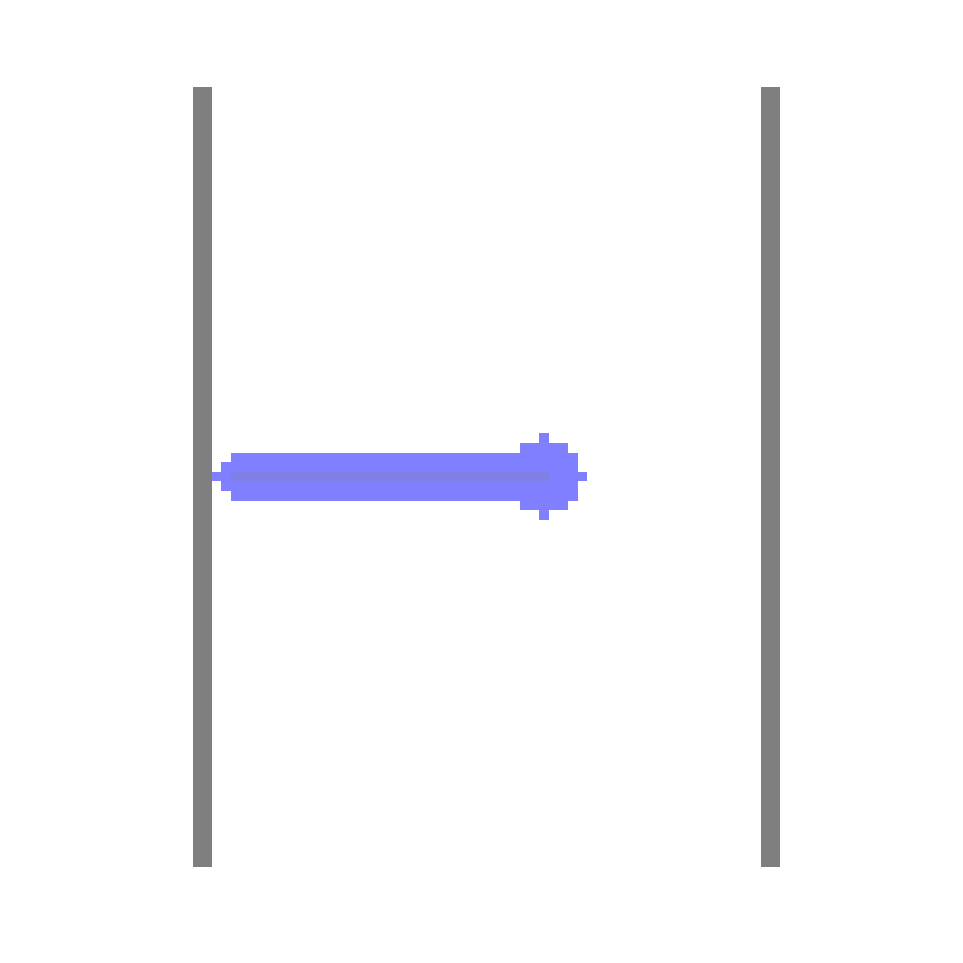
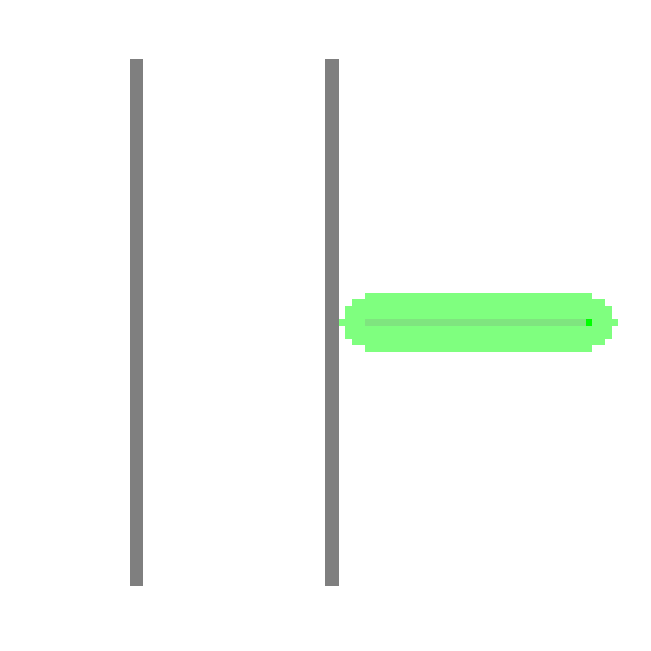
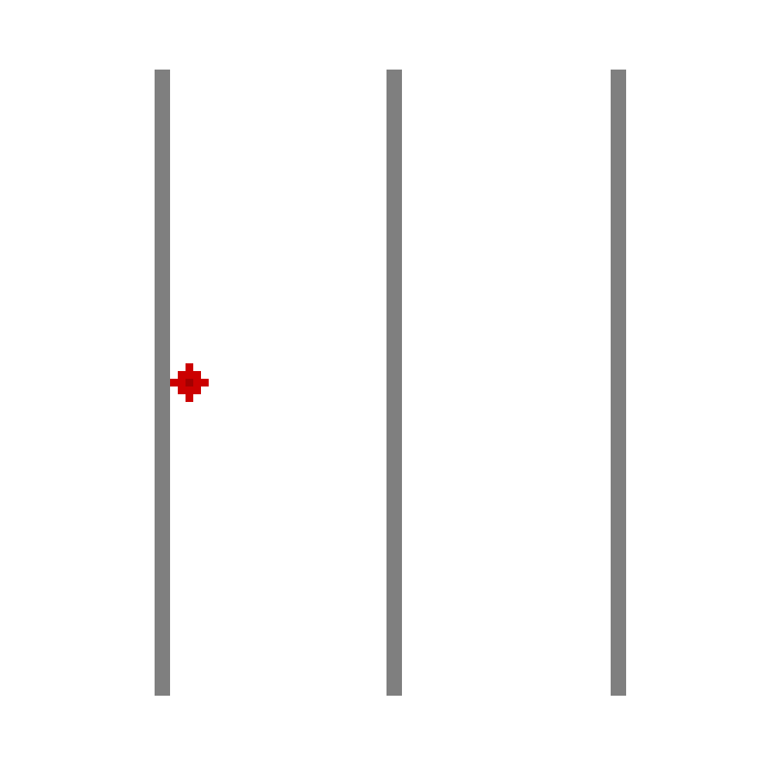


Slide 85
Iterative Routing (when to stop?)

Slide 87
Post-processing Differential Pairs
Pseudo-path to shoulder-paths
Creating vias
Deciding which via connects to which path
Filling in the gaps

Slide 92
DP vias

Slide 96





Pseudo
traces
a.
Pseudo
via
Parallel
DP traces
b.
Pruned
DP traces
c.
d.
A*-routed
connections
e.

Slide 97


Slide 98

Pseudo
traces
Pseudo
via
Parallel
DP traces
Pruned
DP traces
A*-routed
connections

Slide 99
Real-time Algorithm Tuning

Slide 100

Swap start- and
end-terminals
Adjust sensitivity to congestion
Gradually increasing congestion sensitivity.
Iterations with no design-rule violations

Slide 101


Slide 102

Swap start- and
end-terminals
Adjust sensitivity to congestion
Gradually increasing congestion sensitivity.
Iterations with no design-rule violations

Slide 103
DRC-free
solutions
DRC-free
solutions
After increasing
congestion
sensitivity
G-cost
G-cost
G-cost local minima
with design-rule violations
G-cost minima with design-rule violations
Routing Configurations
Routing Configurations

Slide 104

a.
Local minima without
design-rule violations
Global minimum with
design-rule violations
Agregate F-cost
A
B
C
D
Minima with design-rule violations
Routing Configurations
After increasing
congestion sensitivity
b.
Global minimum without
design-rule violations
B
D
Aggregate F-cost
A
C
Local minima with
design-rule violations
Routing Configurations
After extreme increase
to congestion sensitivity
c.
B
D
Aggregate F-cost
A
C
Large cost barrier
to move from A to C
Routing Configurations

Slide 105
After increasing
congestion sensitivity
After extreme increase
to congestion sensitivity
a.
b.
Local minima without
design-rule violations
Global minimum with
design-rule violations
Global minimum without
design-rule violations
B
D
Agregate F-cost
Aggregate F-cost
A
A
B
C
C
D
Minima with design-rule violations
Local minima with
design-rule violations
Routing Configurations
Routing Configurations
Figure 11: Conceptual representation of the total routing cost as a function of routing configurations (a). Increasing the congestion sensitivity (b) increases the cost of unwanted minima without affecting violation-free minima. Extreme increases to the sensitivity (c) cause large barriers between violation-free minima
c.
B
D
Aggregate F-cost
A
C
Large cost barrier
to move from A to C
Routing Configurations

Slide 107
Results: Package Routing

Slide 108

file://wsl.localhost/Ubuntu/home/boyne/autorouter/356n_25mmX25mm_6L_T1024_costZones_diffPairs_relaxedBreakOut_20umRes--c7g.4xlarge--5Jul2024/iteration0465.html

Slide 109


Slide 110






Slide 111





Approximate
die outline
b. Layer 1
a. All layers
c. Layer 2
f. Layer 5
e. Layer 4
d. Layer 3

Slide 112
Approximate
die outline
Package Layer 1
All package layers
Package Layer 2
Package Layer 5
Package Layer 4
Package Layer 3

Slide 113


Slide 114

file://wsl.localhost/Ubuntu/home/boyne/autorouter/356n_25mmX25mm_6L_T1024_costZones_diffPairs_relaxedBreakOut_PNswappable_20umRes--c7g.4xlarge--5Jul2024/iteration0338.html

Slide 115
Results: Package & PCB Routing

Slide 116


Extra
waypoints
added
No extra
waypoints
a.
b.

Slide 117

file://wsl.localhost/Ubuntu/home/boyne/autorouter/356n_25mmX25mm_8L_T1024_costZones_diffPairs_relaxedBreakOut_extraBGAholes_perimPCB_terms--c7g.8xlarge--6Jul2024/iteration0964.html

Slide 118




a. All layers
b. PCB layer 1
d. PCB layer 3
c. PCB layer 2

Slide 119
Package & PCB Layers
PCB layer 1
PCB layer 3
PCB layer 2

Slide 120


Slide 121


Slide 122


Slide 123


Slide 124


Slide 125
Results: Die, Package and PCB Routing

Slide 126

file://wsl.localhost/Ubuntu/home/boyne/autorouter/356n_25mmX25mm_10L_T1024_costZones_diffPairs_dieTerms_extraC4andBGAholes_perimPCB_terms--c7g.16xlarge--8Jul2024/iteration0919.html

Slide 128


Slide 129


Slide 130



Slide 131



Slide 132


Slide 135
Die terminals (green)
Die
area
Die
routing
Package and
PCB area
Unused C4 sites
(white)
C4 connections
(blue)
RDL (red)

Slide 136


